Slide 1
ANCHOR
An ANCHOR, or value offering, defines an organization’s marketplace positioning—targeted customers, products/services, critical hinge points, and results.
An ANCHOR also articulates the trade-offs the organization is prepared to make.
Audience | Most often a specific customer persona. Represents our single most strategic customer.
Niche | Articulates 3-4 ways you will choose to differentiate from the competition. “I choose you over the competition because you are best at…”
Critical Hinge Points | These are 1-2 table stakes needed to heavily influence the organizational design. Must be done well to be considered by the audience, and if not working well today distract from focusing on the Niche.
Omit | Trade-offs.
Results | Desired results that are driving the need for design. How you will measure a successful transformation. Can be KPIs, OKRs, Metrics, and/or outcomes.

Slide 2

ANCHOR
Example
Audience | European price-sensitive travelers who prioritize reaching their destination at the lowest possible fare and are willing to trade service, comfort, and flexibility for cost savings.
Niche | I choose RYANAIR over the competition because… 1. …you are the only airline that consistently gets me to European destinations at the lowest total cost – even after add-ons. 2. …you are the only airline that gets me to so many European cities without layovers. 3. …you are the best at getting me to my destination faster – with less total travel time door to door.
Critical Hinge Points | No matter how strong your differentiation is, it hinges on getting these things right… Safe Operations: Get me to my destination safely every single time. Reliability: Depart and arrive on time. Intuitive Self-Service: Make booking and managing my flight fast and easy – no help needed.
Omits | External: If you deliver your Niche, I am willing to give up… Assigned seating Free luggage and extra carry-ons In-flight meals, amenities, and service Customer service responsiveness Flexible rebooking | Internal: To better deliver our Niche, we must omit or do less… Investment in premium experiences Complex loyalty programs High-cost airport partnerships In-person customer support infrastructure Product diversity that adds complexity or cost
Results | The primary results we expect to achieve by redesigning our organization are… Sustainably offer the lowest fares in Europe, with average prices 30–50% below competitors and a goal of under €40 per ticket Achieve strong profitability at 15%+ operating margins with a CASK below €0.03 Scale rapidly without complexity, reaching 100+ destinations while maintaining 11+ hr/day aircraft utilization on a single fleet type Deliver a fully self-service customer experience, with 90%+ of bookings/check-ins online and <1% requiring agent support
Notes:
Audience Notes:
These travelers often:
Book online with ease
Plan short-haul or weekend trips
Have flexible expectations about amenities
Are motivated by price above all else
Results Notes:
Ryanair’s model is designed to drive industry-leading margins through cost control, scale through low pricing, and volume-driven profitability – not customer satisfaction or experience.
Imagine stepping into the role of an early Ryanair executive leading a bold operating model transformation into the ultra-low-cost carrier we know today. These points reflect the primary results you might expect from that design.
We aim to become the undisputed price leader in European air travel, making flying accessible to millions who previously couldn’t afford it – without relying on subsidies or unsustainable pricing tactics.
Our model must deliver strong margins despite low ticket prices. That means every part of the operation – aircraft use, staffing, service delivery, airport choice – must be optimized to minimize cost per passenger.
See below for more info on CASK
We need to expand our route network and flight frequency while keeping our model simple, replicable, and tightly controlled — avoiding the legacy airline trap of custom solutions, varied aircraft, and service sprawl.
By training customers to book, check in, and manage changes online, we reduce reliance on expensive customer service infrastructure and avoid the cost of high-touch service interactions.
CASK stands for Cost per Available Seat Kilometer.
It’s a key airline industry metric used to measure unit cost efficiency.
Cost = Operating expenses (typically excluding interest/taxes)
Available Seat Kilometer (ASK) = One seat flown one kilometer, whether filled or not
So, CASK = Total operating cost ÷ Total available seat kilometers
Why it matters:
It shows how efficiently an airline operates relative to its size.
A lower CASK means the airline can offer lower fares and still remain profitable.
Ryanair has one of the lowest CASK figures in Europe — a cornerstone of its success.

Slide 3
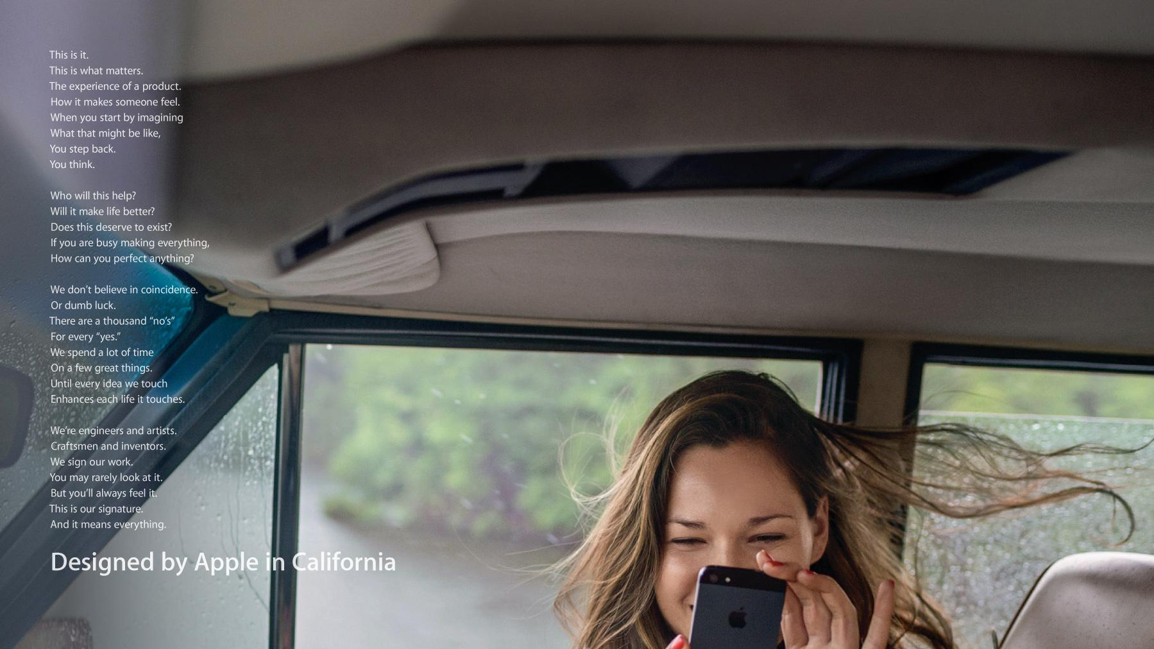
There are a thousand “no’s
For every “yes.”
We spend a lot of time
On a few great things

Slide 4
Questions to Help in Developing Trade-Offs
Average Versus Great
What must we be average at to be great at something else?
Do Less Frequently
What could be done less frequently or stopped altogether?
Focus on Right Opportunities
What work or opportunities should the organization not be saying “yes” to doing?
Resource Work Differently
What work may need to be resourced differently? What resources should be free up to work on more strategic work?
Work Activities At Odds
Are there activities that are inherently at odds? (Highest, Customized Service versus Lowest, Standardized Service or Innovation versus Speed)
No One Cares or Needs
What work are we doing today that isn’t needed or required in the future?

Slide 5
Identifying Omits
There are two primary types of Omits:
External Focused: Omits from the Audience’s perspective.
Things they would be willing to give up to take advantage of the differentiated value you offer.
Things they need to give up so you can better provide your differentiated value offering.
Critical because they force us to consider:
How valuable our value offering really is to our Audience.
What we can get away with not offering that maybe we falsely assume we need to offer.
Internal Focused: Omits from your perspective.
Things your organization needs to stop doing or do less of in order to drive more focus on delivering your differentiated value offering.
Critical because they force us to consider:
What we spend time and resources on that are not value added given our strategy
What we may be doing that detracts from or even contradicts what we are supposed to be the best at.
Notes:
Wo

Slide 6
ANChOR
Functional, COE, Shared Service or Team Context
Audience | For a function this often aligns with our primary stakeholder or a subset/persona of that group. It represents our single most strategic customer for the next 3-5 years. Avoid listing all stakeholders. Design is about focus.
Niche | Articulates 3-4 things you can do to provide the most value to your audience. What do they want you to be good at? If they had the choice, why would they use you vs. an external firm? What value do you provide that no one else could provide them? This may include elements of reliability, speed, or excellence in a particular service or internal product you provide. This enables them to do their most strategic work better or allows them to focus on it. This is the work that when done right, makes them love you and reliant on you. It’s best decided by filling in the following statement “Besides the table stakes, the most valuable thing you can do for us is...”
Critical Hinge Points | The Critical Hinge Points are 1-2 table stakes (not included in your Niche) that also need to heavily influence the design of your organization. For some functions or teams, these may be covered already in your Niche Statements. This is a place to capture elements that aren’t necessarily the most recognized by the Audience, but they must be protected or heavily considered as you design the organization. They also may be high level elements that are currently broken and causing the organization significant problems. These problems distract from focusing on the Niche and must be resolved in the design.
Omits | At the functional or team level, Omits may include internal customers or stakeholders we won’t serve or serve with a lower degree of touch, products, services, or features we won’t offer, ways we won’t engage, parts of the business we won’t support and things we’ll just be average at. They may include closing business units, sunsetting products or stopping certain things we do today. They may also include things we need to keep doing but do less of to a lesser degree of excellence.
Results | These are the desired results that are driving the need for design. They may include cost cutting targets, growth targets, growing into new markets or new revenue or margin models. We are answering the question, “What enterprise success look like?”

