Slide 1
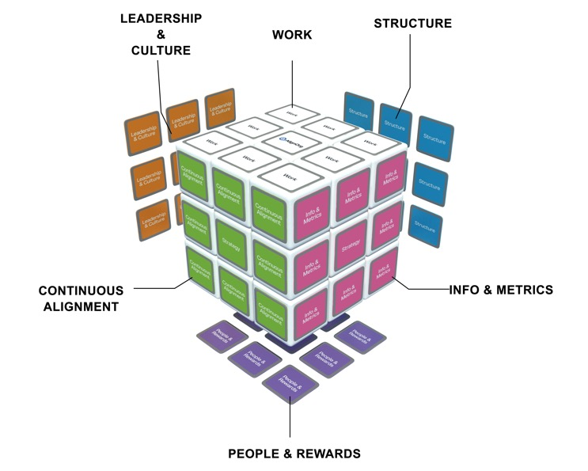
AlignOrg Solution’s Organization Design Model
Strategy
Capabilities
Aligning Organizing Choices
Environment
Results
Strategy
Organizations Implications
Macro
Micro
Alignment is achieved by following the design sequence
How do we organize to best leverage organization capabilities?

Slide 2
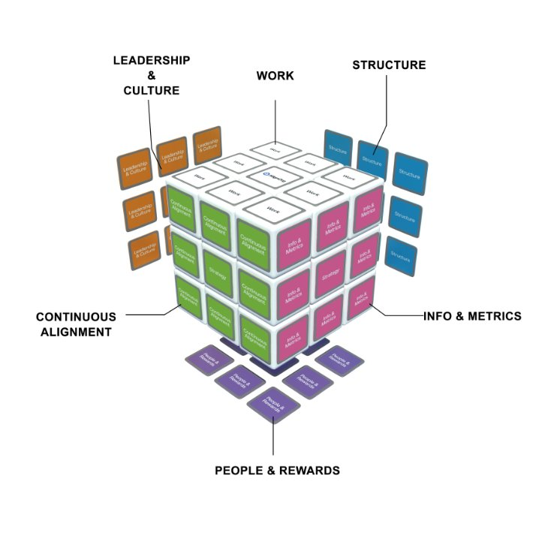
Mastering the Cube
Preparing the Micro Design Outcomes
Final alignment—Summary of recommended
choices and choices still misaligned.
Scope of micro design.
Additional transformation
plans.

Slide 3
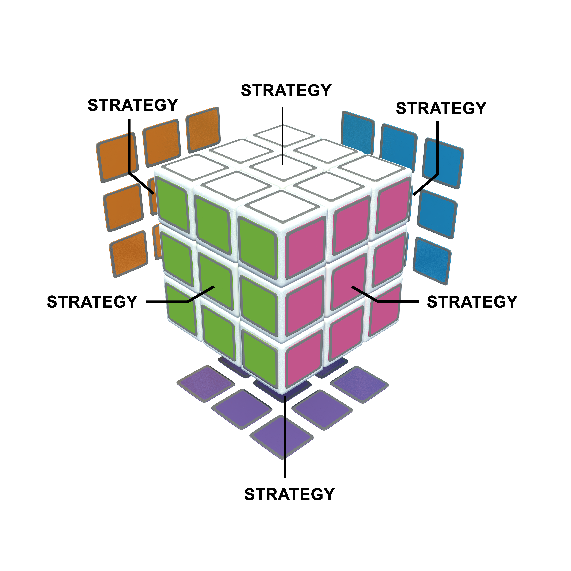
Final Alignment
At the end of the macro design effort, we bring all the choices together to ensure they are aligned and mutually reinforcing.
“Strategy is . . . creating fit and integration among
[design choices] resulting in competitive sustainability.”
-Michael Porter
Harvard Professor

Slide 4
Organizing Choices
A. Work
How products and services are produced.
Work processes – Sequence of activities and what each person is responsible for.
Tasks, methods, procedures and systems needed to do it.
Enabling technologies, equipment, physical facilities and layout.
B. Structure and Governance
The way work is organized.
Jobs, groupings of workers, accountabilities and reporting relationships.
Linking mechanisms.
What decisions are made, where they are made, how they are made.
Policies and controls.
F. Leadership and Culture
Shared assumptions, beliefs, behaviors and norms of the workforce.
Other “cube” choices influence culture and mold beliefs and behaviors.
Leadership behavior exerts a strong force on culture.
E. Continuous Alignment
How the organization evaluates itself and learns and improves daily.
Systems that keep the processes controlled and improving daily.
Needs result from environmental shifts, design drift, and/or deteriorating performance.
C. Information and Metrics
Information needed to make decisions.
How info will be collected, documented, stored, retrieved, viewed, analyzed, exchanged, reported and distributed.
Includes customer information systems, financial systems and measurement systems.
D. People and Rewards
Competencies, attraction, selection, orientation, assimilation, skill development, skill certification, knowledge sharing and knowledge transfer.
Performance contracting, feedback, career development and succession planning.
How members are recognized and compensated (formally and informally).

Slide 5
Aligning Organizing Choices - Example
Work Be a virtual organization without the physical assets New troubleshooting process Use Uber for member transport Design call flow around problem ownership Use triggers to create out-bound campaigns Define “advocacy” and train agents on what it sounds like in calls | Structure / Governance Develop regional teams Span of control of 15 or less Create feedback loops on issues and reach closure when we can Organize agents into “issue” type teams, e.g. claims Structure so that CSRs can easily get answers from internal transfers
Leadership and Culture Recognize, reward and celebrate customer wins Visible leadership that models customer centric behavior “Fail fast” leadership mindset of CI Partnership with key areas by design Shift from answering calls to advocacy | Information Metrics Real time reporting on issue progress Measure customer satisfaction by agent and by team Recognize advocates via customer sat metrics Info for supervisors / managers on coaching opportunities
Continuous Alignment Define periodic review and update of complex processes Agile process updating (fast review and adoption) | People/Rewards Train agents on critical thinking and benefit plans Empower agents to own the problem Hire “controllers” and / or for controller mentality Develop hiring profile for advocates Train agents on claims

