Slide 1
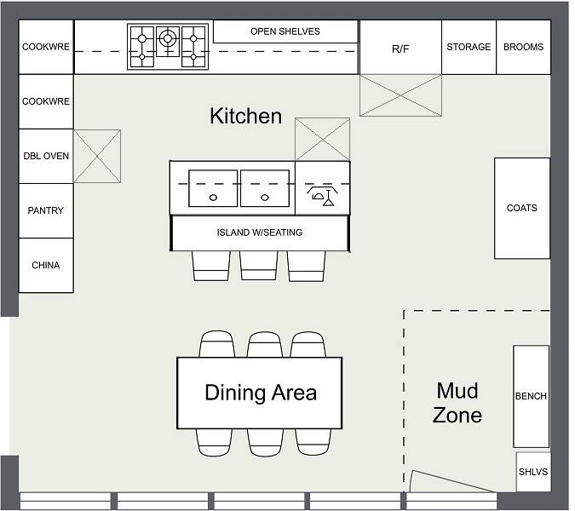
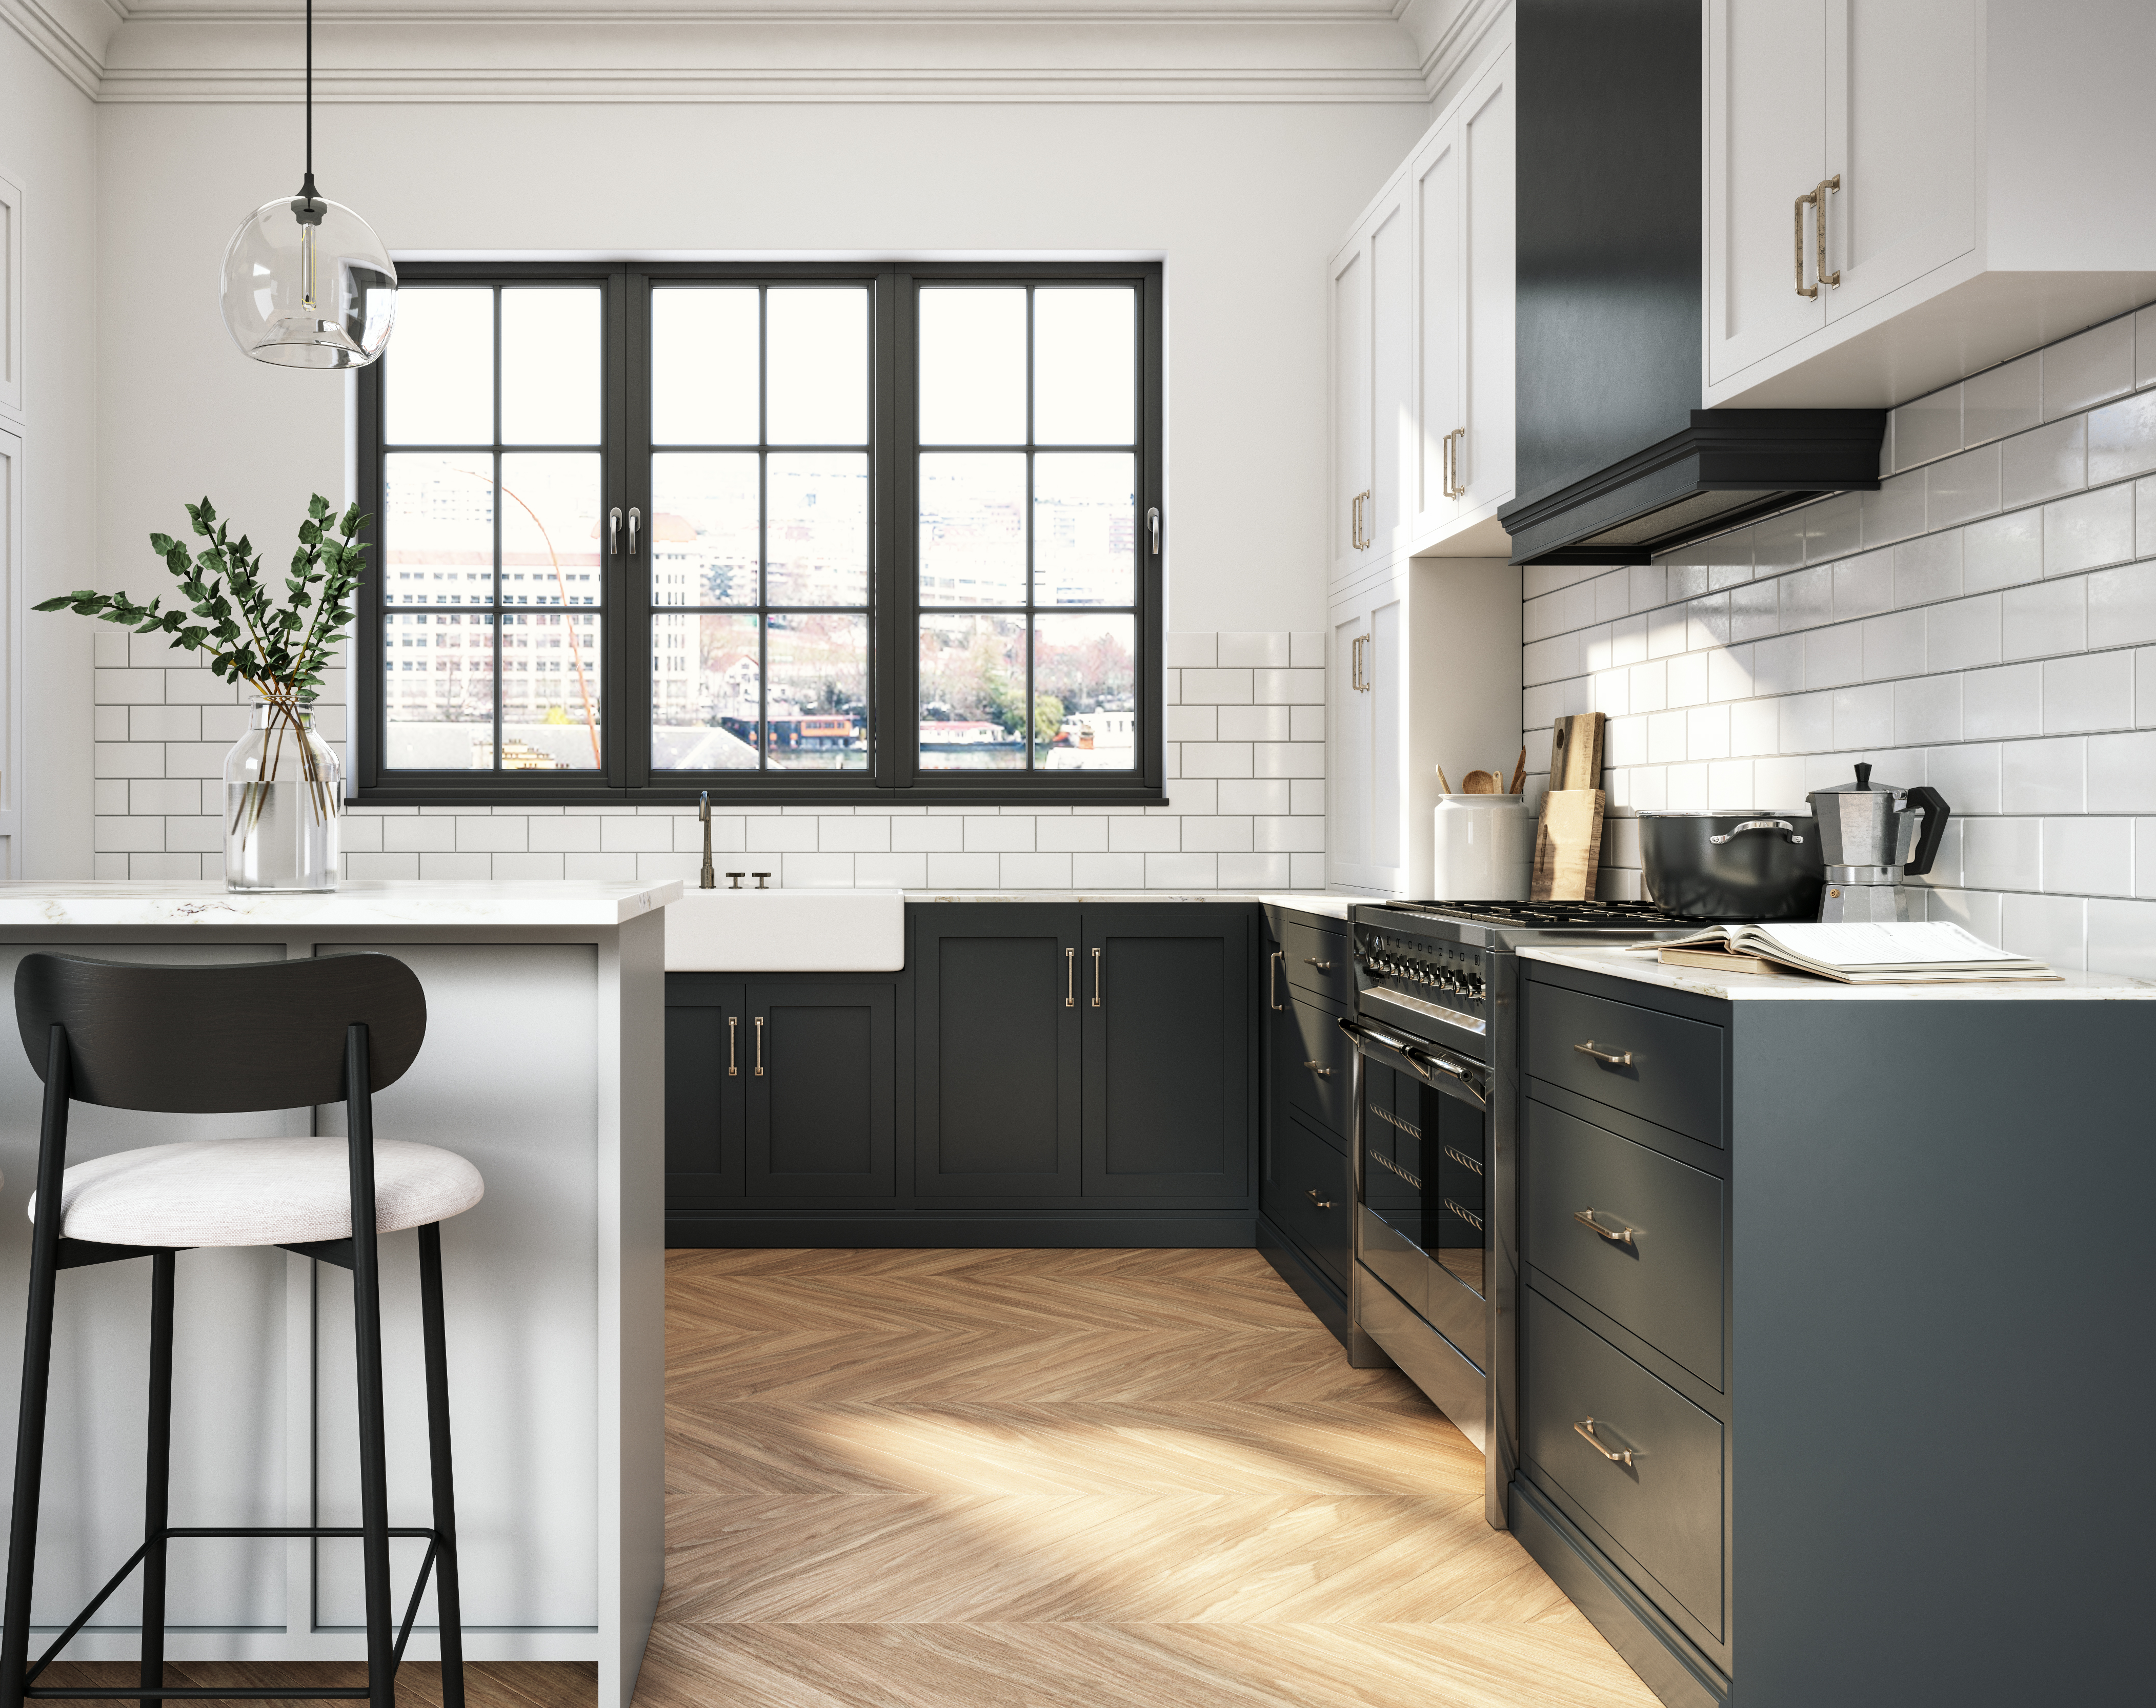
Organization Design Criteria
Design Criteria are statements about what is considered optimal from a design and strategic perspective. They provide specific guidance about what the design should and should not be.
Example: Kitchen Remodel
Design Criteria
Kitchen Design
Design Implementation
“Must Haves”
Double Oven, Deep Sink
“Standards or Conventions”
Sink needs to be near dishwasher
“Constraints”
The room is 12 x 16, $20k budget

Slide 2
Developing Design Criteria
We will surface, identify, validate and then revisit the specified design criteria throughout the design process.
Design Criteria
Organization Design
“Must Haves”
Double Oven, Deep Sink
“Standards or Conventions”
Sink needs to be near dishwasher
“Constraints”
The room is 12 x 16, $20k budget

Slide 3
Design Criteria
Customer Care Example
The new design will be a success if it…
#​ | Design Criteria​ Meaningful, Applicable, Measurable​ | Satisfied? Yes, No, Partially
1 | Consistent experience FOR ALL – affordable quality care where customer always wins 50 / 50 % call.
2 | Advocacy – “You’ve got my back” branded experience.
3 | Flexible organization scales up and down with volume requirements.
4 | Become a net exporter of talent.
5 | Must design to be regulatory compliant.
6 | Lead a culture of simplification, continuous improvement and change.
7 | Proactive and transparent performance management and reporting (both internal and external).
8 | Multi-channel tools, processes and data to meet customers where they are.
9 | Establishes clear lines of accountability and ownership​

