Slide 1
Micro Facilitation
Meeting Subtitle Goes Here, Delete if Needed
Presenter or Team Name
Date

Slide 2
Set-Up and Introduction

Slide 3
Micro Design Team
Executive Sponsor:
Name – Title
Project Lead:
Name – Title
HR Project Lead:
Name - Title
Consultant Facilitators:
AlignOrg Solutions
Name
Name
Design Team
Name - Title

Slide 4
Objectives
Purpose (Why?):
Text
Method (Methods, Tools, and Techniques):
  X
  X
  X
  X
End-state (What does success look like?):
Text

Slide 5
Micro Design Workshop Agenda
3 Day
Date | 08:00 – 17:00 | Date | 08:00 – 17:00 | Date | 08:00 – 17:00
SET-UP AND INTRODUCTION Introductions and session set-up (objectives, agenda, and design approach) STRATEGY AND DIRECTION Review and update design criteria Review macro design WORK PROCESSES Evaluate processes to determine degree of change required and timing Design processes to effectively deliver distinctiveness OR to maximize efficiency. Use value point mapping or swim lane mapping |  | Review process designs from Day 1 Identify critical linkages STRUCTURE AND GOVERNANCE Adjust organization structure based on process design Evaluate spans of control Roll up linkages |  | CULTURE AND LEADERSHIP Identify strategic leadership behaviors PROCESS TESTING Perform use case testing across processes designed BRIDGE TO IMPLEMENTATION AND SUSTAINABILITY Scope the transition from here to implementation using a timeline
Continue process design Identify key decision points Identify tools and technologies required to support processes Develop process metrics Perform process testing by mapping into a swim lane Perform process improvement checks Wrap-up Day 1 |  | Develop responsibility charts INFORMATION AND METRICS Roll up process metrics to drive ANCHORs PEOPLE AND REWARDS Develop role profiles Estimate staffing shifts/impacts (by role and functional area) Wrap-up Day 2 |  | Perform stakeholder categorization and analysis Determine immediate next steps Develop a communication plan
EXAMPLE
Customize as needed.
See Citrix Files for Additional Agenda Examples.

Slide 6
Micro Design Workshop Agenda
Completed
Date | 08:00 – 17:00 | Date | 08:00 – 17:00 | Date | 08:00 – 17:00
SET-UP AND INTRODUCTIONS REVIEW MACRO DESIGN AND DESIGN CRITERIA Review and update design criteria Review macro design Determine degree of process change required and timing PROCESS 1 Begin process mapping |  | PROCESSES 2 AND 3 Process mapping Decision points Linkages Metrics Testing Improvement checks |  | CULTURE AND LEADERSHIP CASE TESTING BRIDGE TO IMPLEMENTATION AND SUSTAINABILITY Scope
Continue process design, including: Processing mapping Decision points Linkages Metrics Testing Improvement checks WRAP-UP DAY 1 |  | ADJUST STRUCTURE LINKAGE ROLL-UP RESPONSIBILITIES ROLL-UP METRICS ROLL-UP ROLES AND STAFFING IMPACTS WRAP-UP DAY 2 |  | Stakeholder analysis Immediate next steps Communication plan
EXAMPLE
Customize as needed.
See Citrix Files for Additional Agenda Examples.

Slide 7
The Ground Rules
Keep an open mind.
Focus and use your time wisely.
Allow the facilitator to facilitate.
Trust the process.
Be respectful.
What more?
EXAMPLE
Customize as needed

Slide 8
The Organizational Cube

Slide 9


The Organizational Cube
Organizations are like Rubik’s® Cubes.
Without the right processes and methods, solving the puzzle can be challenging.

Slide 10

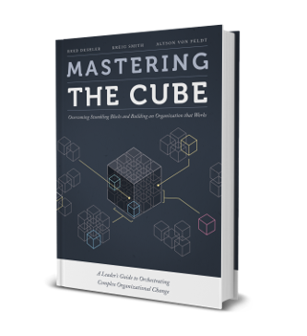
The Organizational Cube
Like a Rubik’s® Cube, organizations can be aligned by using right process and tools.
We’ve outlined the method for solving the organizational cube in our book.
The current world record holder for solving the Rubik's Cube is Yusheng Du.

Slide 11
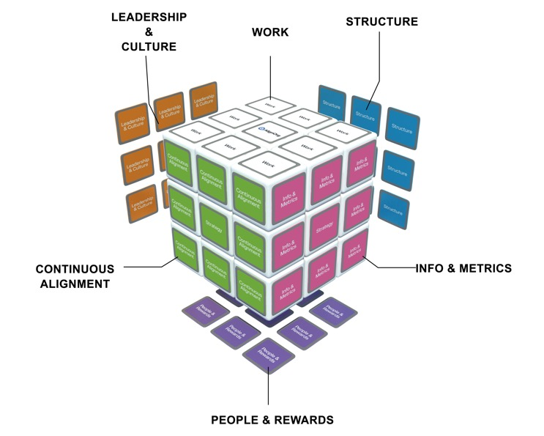
Organizations Are Puzzles to be Solved
AlignOrg Solution’s Organization Design Model
Strategy
Capabilities
Aligning Organizing Choices
Environment
Results
Strategy
Organizations Implications
Macro
Micro
Alignment is achieved by following the design sequence
How do we organize to best leverage organization capabilities?

Slide 12
Organizing Choices
A. Work
How products and services are produced.
Work processes – Sequence of activities and what each person is responsible for.
Tasks, methods, procedures and systems needed to do it.
Enabling technologies, equipment, physical facilities and layout.
B. Structure and Governance
The way work is organized.
Jobs, groupings of workers, accountabilities and reporting relationships.
Linking mechanisms.
What decisions are made, where they are made, how they are made.
Policies and controls.
F. Leadership and Culture
Shared assumptions, beliefs, behaviors and norms of the workforce.
Other “cube” choices influence culture and mold beliefs and behaviors.
Leadership behavior exerts a strong force on culture.
E. Continuous Alignment
How the organization evaluates itself and learns and improves daily.
Systems that keep the processes controlled and improving daily.
Needs result from environmental shifts, design drift, and/or deteriorating performance.
C. Information and Metrics
Information needed to make decisions.
How info will be collected, documented, stored, retrieved, viewed, analyzed, exchanged, reported and distributed.
Includes customer information systems, financial systems and measurement systems.
D. People and Rewards
Competencies, attraction, selection, orientation, assimilation, skill development, skill certification, knowledge sharing and knowledge transfer.
Performance contracting, feedback, career development and succession planning.
How members are recognized and compensated (formally and informally).

Slide 13
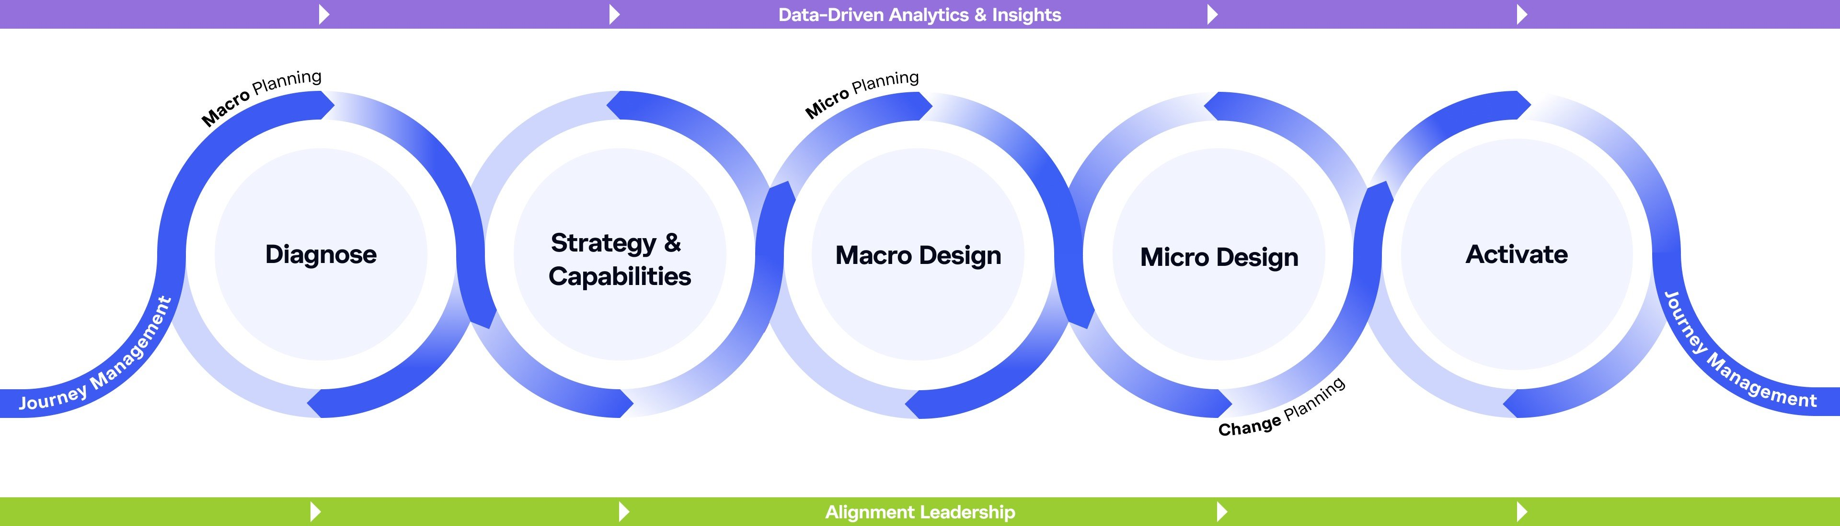
Organization Transformation Roadmap
The AlignOrg Approach
How will the initiative be set-up for success?
How does your organization intend to “win”?
How should work and resources be configured to best enable strategy?
How will the new organization work and what capabilities need to be redesigned to drive execution?
How do we manage the change so we can realize the benefits of the new design?

Slide 14
Organization Alignment Activities: What’s Coming
Alignment Leadership
Strategy and Macro Design | Micro Planning | Micro Design | Change Management Planning | Implementation and Sustainability Journey Management
Purpose Set vision and strategy Identify and design strategic capabilities Develop operating model Determine organization structure at highest levels Set guidelines for micro / operational design | Select leaders for highest levels (L1 – L2) Select leaders/ sponsors and project manager for micro designs | Purpose Design Micro level choices | Select Leaders for L3 – L6(x) Select Project Manager for Journey Mgmt.
CHANGE MANAGEMENT
We are realizing our goals.
Detailed schedule
Communications strategy/plans
Physical move planning
PMO
Equipment movement
Financial/budget planning
Individual transition management
Organizational change management
INTEGRATION
PEOPLE MOVEMENT
I’m in my new role.
Job Creation
Descriptions
Grading
Success Metrics/rewards
Compensation
Legal review
Job Selection
Sourcing strategy
Post jobs
Apply for jobs
Selection
Job Moves
Changes to system
Physical moves
Budget changes
Security changes
Performance management plans
Skillset transfer
Training
On-boarding
Job training
Training development
Training
delivery
Design Area 1 (Work stream)
Design Area 2 (Work stream)
WORK LAUNCH
I’m doing my new role.
Processes
Level 3(x) process design
Work Guides
Job aid
Scripts
SOPs
Templates
Knowledge mgt. transfer
Metrics
SLAs
Operating metrics
Output metrics
Activities
Develop
Test
Train
Implement
TECHNOLOGY
I have the tools to do my new role
Requirements
Detailed design documents
Configuration parameters
Reporting
Solutions
Activities
Solution selection
Installation
Configuration and test
Go live
Design Area 3 (Work stream)
Journey Management

Slide 15
Micro Design Drill-Down
Facilitation Roadmap (1 of 2)
Strategy
Work
Structure
Info. and
Metrics
STRATEGY IMPLICATIONS
PROCESS DESIGN
(Value Point Mapping)
ORGANIZING RATIONALE AND ORGANIZATION CHART
LINKAGE DESIGN
DECISION
RIGHTS
ORGANIZATION AND PROCESS METRICS
DESIGN PRINCIPLES AND CRITERIA
Purpose | Clarify what is most important to the customer and how the organization will meet those needs to deliver value. | Map how work will be performed to deliver value against the strategy. Capture how work will be performed across different parts of the organization. | Explore organizing themes along with their benefits and risks, and define organization structure options | Define mechanisms needed to enable cross-organization and cross-process interdependencies | Identify who will assume various levels of responsibility for making decisions and performing activities | Develop the input, in-process, output and impact metrics that will focus performance and behaviors
Output | Value Offering consisting of: Audience, Need, CHannel, Omits, and Revenue. | Maps that show the key activities, major outputs, tools/technology and intersections with roles/responsibilities needed to enable future work. | Organizing rationale used to analyze structure options, as well as organization charts (reporting relationships) | Linkage details about how these mechanisms work and who will ensure execution | Responsibility Chart (RACI or CIDER) | Metrics Design and Measurement Planner

Slide 16
Micro Design Drill-Down
People and Rewards
Culture and
Leadership
Scenario
Testing
Micro to
Journey Bridge
STRATEGIC CULTURAL BEHAVIORS AND LEADERSHIP PRACTICES
USE CASE TESTING
BRIDGE TO REALIZATION
ROLE
DESIGN
STAFFING
DESIGN PRINCIPLES AND CRITERIA
Purpose | Describe roles and responsibilities for new/changed positions | Identify staffing drivers and/or ratios to rationalize the numbers of roles needed for key processes or functions | Identify key strategic behaviors or leadership practices that need to change – and how – to deliver the strategy and design intent | Facilitate stakeholder testing of design choices in real-life scenarios to identify gaps, risks or integration needs | Develop high-level plans to transition to and realize the recommended alignment choices
Output | Role profiles | Staffing estimates and assumptions | Strategic cultural behaviors and leadership practices chart | Use cases that demonstrate how key actions and decisions will work | High-level transition/implementation plan

Slide 17
Strategy and Macro Design Outcomes

Slide 18
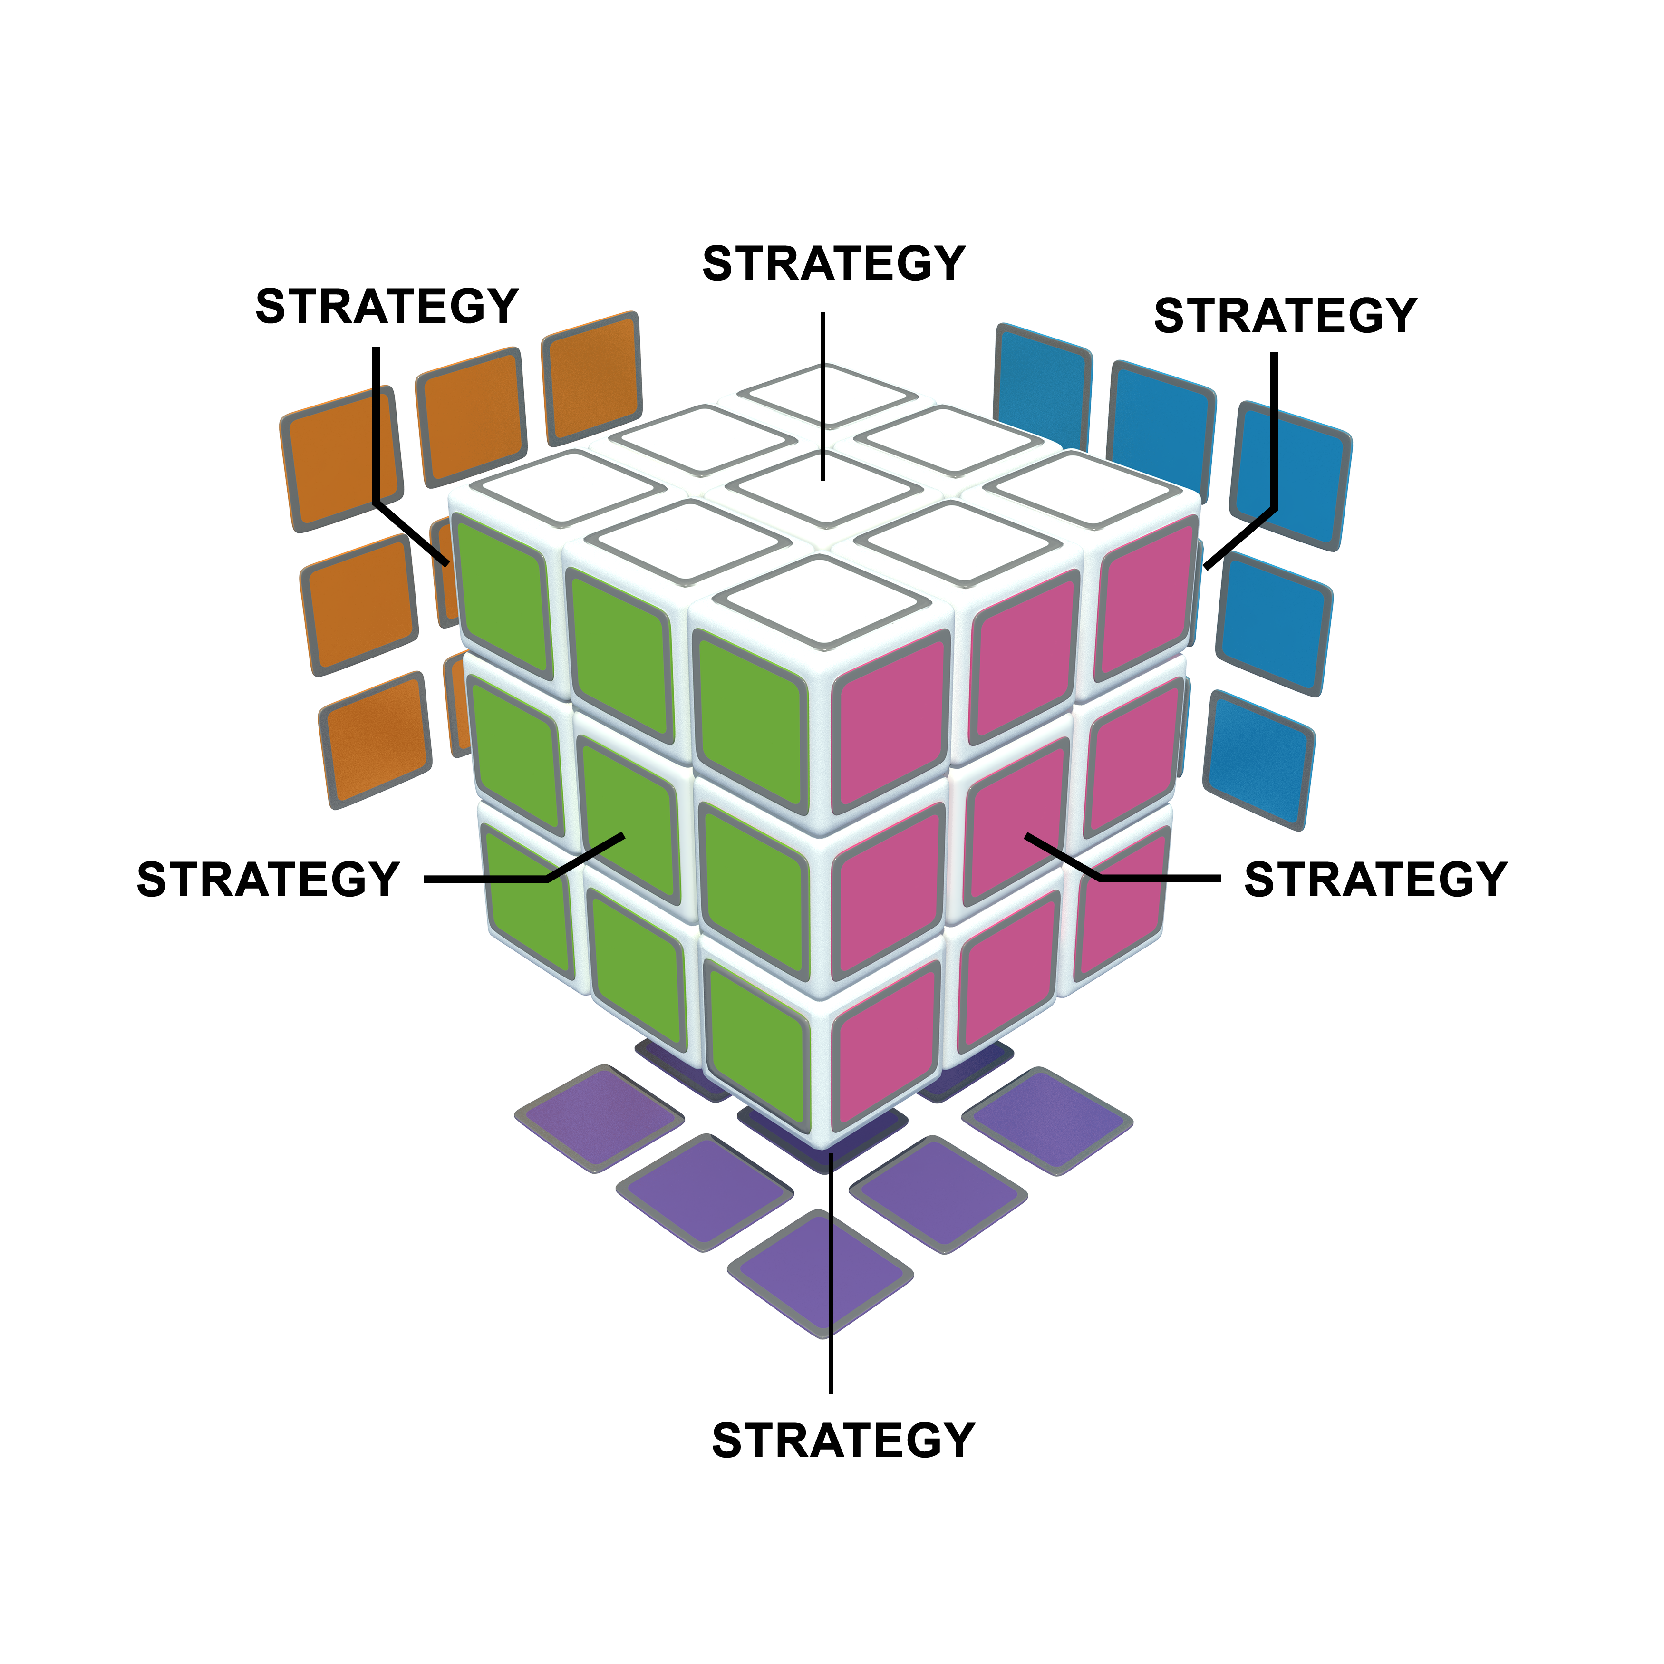
Mastering the Cube
Strategy and Macro Design Outcomes Review
Understand stakeholder priorities (design criteria)
Review ANCHOR and trade-offs
Review capabilities required
Review work categorization

Slide 19
Design Criteria
Example
The new design will be a success if it…
#​ | Design Criteria​ Meaningful, Applicable, Measurable​ | Satisfied? Yes, No, Partially
1 | The model is nimble and is able to expand and contract easily with growth and/or change in direction.
2 | The linkages and decision processes for the organization must be established and clear.
3 | We are more customer-centric and better able to absorb increasing complexity for customers.
4 | The structure is different in a way that allows us to better meet operational needs and optimize the customer experience.
5 | We are spending our time doing the right work and doing it in a way that allows us to service various customer types based on their varying needs.
6 | Our alignment with service ops and the segments is reflected and supported in the structure.
7 | There are more efficient processes, more transparency and better collaboration across departments/segments (model/roadmap).
8 | We have sped up/improved decision-making and communication internally, thus increasing our productivity.

Slide 20
Design Criteria
Breakout
As a group, brainstorm the design criteria
we should use to guide our decision making
Things to keep in mind…
After brainstorming, refine the criteria by ensuring they are meaningful, applicable, and measurable.
Narrow down the new criteria to no more than 4.

Slide 21
Design Criteria
Template
The new design will be a success if it…
#​ | Design Criteria​ Meaningful, Applicable, Measurable​ | Satisfied? Yes, No, Partially
1
2
3
4
5
6
7
8

Slide 22

ANCHOR
Example
Audience | Air travelers across Europe willing to trade convenience and service for the lowest priced fares.​
Need | I choose RYANAIR over the competition because:​ “They allow me to travel at the lowest possible cost.” ​ “I appreciate the variety of destinations they serve compared to other discount carriers.” ​ “It takes less total travel time to get to where I want to go.”​
Channel | Internet ​ Call Centre​
Omit | “When I fly RYANAIR I am willing to give up:​ Assigned seating,​ Amenities (e.g., meals, two carry-ons, boarding pass reprints, rebooking, non-reclining seats), and ​ Free baggage.​
Revenue | Lowest priced fares compared to competition.​

Slide 23
Differentiating Capabilities
Example
Differentiated strategy requires differentiated activities
  From RYANAIR’s ANCHOR:
  “They allow me to travel with my family at the lowest possible cost.”
  “I appreciate the variety of destinations they serve compared to other discount carriers.”
  “I arrive at my destination on time to continue with my plans.”
Lowest Possible Cost
Efficient aircraft fleet management
Outsourced/contracted airport operations
Airport partnering and facilities management
Aircraft gate turnaround measurements and insight devs
Pay for performance
Union and vendor management
Limited customer service

Slide 24
Work Categorization Questions
Competitive Activities | Competitive Enabling Activities | Necessary Activities | Compliance
Does this work have a direct impact on gaining market share to make your strategy happen?​ ​ Does it directly impact your ANCHOR(s)? ​ ​ Will the activity directly create sustainable differentiation?​ ​ If we were forced to give up control of work, would this be the last thing we would give up? ​ | Are the outputs of this work used by or consumed by a competitive work activity? ​ ​ Does it directly enable a competitive work activity?​ ​ Do we do this work because of our company’s values/ beliefs? | Is it essential to the business, but not to gaining market share?​ ​ Is it only a potential disadvantage? ​ ​ Could we afford to be at par with our competitors? ​ ​ | Do we do this because we don’t want to go to jail or get fined?​ ​ If allowed, would we stop doing this work?
Effectiveness
Efficiency

Slide 25
Aligning Organizing Choices
Work Be a virtual organization without the physical assets New troubleshooting process Use Uber for member transport Design call flow around problem ownership Use triggers to create out-bound campaigns Define “advocacy” and train agents on what it sounds like in calls | Structure / Governance Develop regional teams Span of control of 15 or less Create feedback loops on issues and reach closure when we can Organize agents into “issue” type teams, e.g. claims Structure so that CSRs can easily get answers from internal transfers
Leadership and Culture Recognize, reward and celebrate customer wins Visible leadership that models customer centric behavior “Fail fast” leadership mindset of CI Partnership with key areas by design Shift from answering calls to advocacy | Information Metrics Real time reporting on issue progress Measure customer satisfaction by agent and by team Recognize advocates via customer sat metrics Info for supervisors / managers on coaching opportunities
Continuous Alignment Define periodic review and update of complex processes Agile process updating (fast review and adoption) | People/Rewards Train agents on critical thinking and benefit plans Empower agents to own the problem Hire “controllers” and / or for controller mentality Develop hiring profile for advocates Train agents on claims

Slide 26
Work

Slide 27
Micro Design Drill-Down
Facilitation Roadmap (1 of 2)
Strategy
Work
Structure
Info. and
Metrics
STRATEGY IMPLICATIONS
PROCESS DESIGN
(Value Point Mapping)
ORGANIZING RATIONALE AND ORGANIZATION CHART
LINKAGE DESIGN
DECISION
RIGHTS
ORGANIZATION AND PROCESS METRICS
DESIGN PRINCIPLES AND CRITERIA
Purpose | Clarify what is most important to the customer and how the organization will meet those needs to deliver value. | Map how work will be performed to deliver value against the strategy. Capture how work will be performed across different parts of the organization. | Explore organizing themes along with their benefits and risks, and define organization structure options | Define mechanisms needed to enable cross-organization and cross-process interdependencies | Identify who will assume various levels of responsibility for making decisions and performing activities | Develop the input, in-process, output and impact metrics that will focus performance and behaviors
Output | Value Offering consisting of: Audience, Need, CHannel, Omits, and Revenue. | Maps that show the key activities, major outputs, tools/technology and intersections with roles/responsibilities needed to enable future work. | Organizing rationale used to analyze structure options, as well as organization charts (reporting relationships) | Linkage details about how these mechanisms work and who will ensure execution | Responsibility Chart (RACI or CIDER) | Metrics Design and Measurement Planner

Slide 28
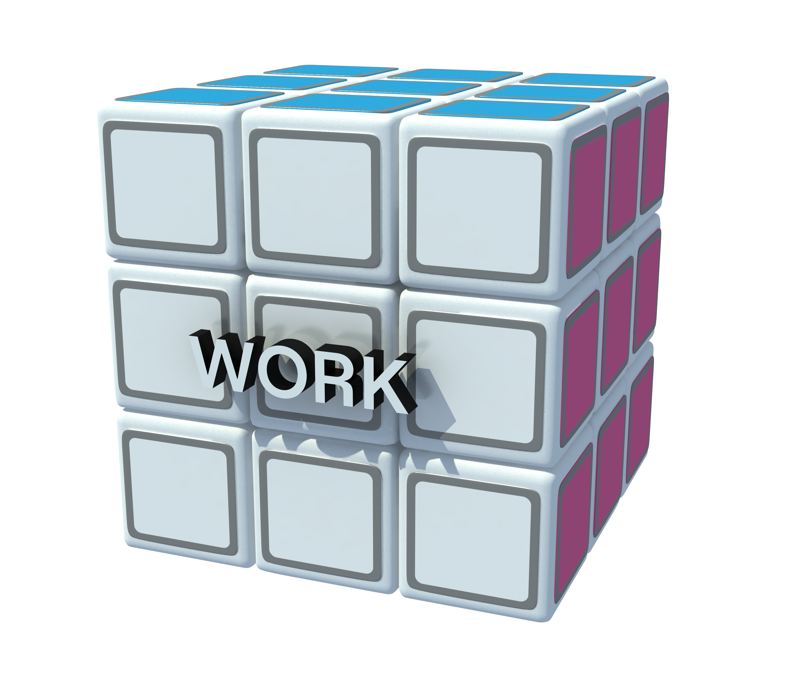
Mastering the Cube
Design new and redesign existing processes to deliver the ANCHOR
Develop process decision rights, roles,
metrics, and linkages

Slide 29
Choice Prioritization
Example
 |  | WHEN? |  | HOW?
Priority | Choice (+ Cube Category) | Before Go Live | After Go Live | Redesign Needed (Outputs/ Activities Change) | Role Clarification Needed (Jobs Change) | Minor Process Adjustments Needed (Process Owner’s Discretion) | Outsource? | Work Stream/ Owner/ Comments | Date
1 | Vendor Management (Work) | X |  | X |  |  |  | Corporate, Analytical Ops, US and Ex-US Quality Operations.
2 | PQM/CMC Strategy (Work) | X |  |  | X |  |  | New Product and Technical Support, US and Ex-US Quality Operations, Analytical Operations.
3 | Knowledge Management (Work) |  |  | X
4 | Project Management and PMO process/governance (Work)
5 | Quality function metrics and process (Work)

Slide 30
Choice Prioritization
Breakout
Prioritize design choices and determine when to implement each one.
Instructions
List the key DESIGN CHOICE and its cube category for your organization.
Determine the TIMING of the intervention (now--during a transition period, or later--after implementation of the new design).
Determine the TYPE INTERVENTION required for each work process or organization area/group.
Identify the WORK STREAM or person who will own the intervention and any other comments, such as possible team members (finalize after work stream planning).
Set the COMPLETION DATE for the intervention.

Slide 31
What is a Process?
A process is a series of interrelated activities that transforms various inputs into whole, consumable outputs.
Completed Application
Sales Process
Customer Data
Credit Underwriting
Underwritten File
Documentation
Ongoing Customer Service
Funding
Collections and Customer Service Process
Document File
Booked Deal
Cash in Hand

Slide 32
Process Design
There are two basic approaches to designing processes
Design “from scratch”
This approach is used for brand new processes. It is also used for existing processes that need to be drastically different in the future in order to meet design criteria or generate the desired outputs.
A key feature is the Value Point Map (VPM)
Redesign an existing process
This approach is used for existing processes that aren’t fundamentally going to be different in the future, though they may need drastic improvement or change. This approach omits the Value Point Map and moves directly to swim lane diagram (Begin with Swim)

Slide 33
End Game for Processes
Competitive and Competitive Enabling Processes
Does this activity create sustainable differentiation? Does it set us apart?
Is this different work from what other organizations do? Or, is this the same work but done very differently?
Necessary and Compliance Processes
Is this work as efficient as it can be?
Is it lean? Is there any waste?
Does this process deliver outputs at par with basic requirements and expectations, but not more?

Slide 34
Value Point Map
Process: ”Build IT Solution”
4 – Executed / Deployed
1b​.
. . . and the
inputs.
2.
Design the Value Points.​
1a
Identify outputs . . .
INPUTS​
Receive prioritized and approved and are assigned, scheduled, and framed​.
1 – Initiated
2 – Planned
3 – Built
5 –Closed
OUTPUTS​
Project deployed to production​.
Activities:
Define full project team (SMEs, business process consultant, C.H).
Define project charter.
  Agile or waterfall?
Activities:
Onboard project team.
Define requirements high level.
Buy or build?
Continue.
Vendor needed?
If NO, value point 3.
If YES, continue.
Complete SEM process and document.
Vendor needed?
If NO, Return to high level requirements or vendor.
If YES, continue.
Negotiate and onboard contracts – as needed.
Define system monitoring (performance and security).
Define training plan, as needed.
Define change management plan, as needed.
Follow release management process – including asset management plan.
Activities:
Follow agile or waterfall methodology.
Develop solution – environment build and deploy – dev. test, production.
Define test plans – dev, QA, UAT.
Test Solution – dev, QA, UAT.
Conduct code review – as needed.
Business user sign off?
If YES, continue to Executed or agile process.
If NO, Activity 2.
Activities:
Document process by BPC.
Deploy change management plan, as needed.
Deploy release notes – as needed.
Execute training.
Follow change control process.
Deploy system and process.
Deploy system monitoring.
Provide initial support.
Activities:
Hand-off to service desk tier 3.
Initiate metrics tracking.
Update asset management system.
Document lessons learned.
Linkage:
Project management link to portfolio management for statusing.
3.
Design the Activities.​
4.
Design the Key Decision Points.
6. Map the Roles.
7.
Identify process metrics. They are further designed in the Measurement Planner.
5.
Design the Tools and Technologies
8.
Process flow is documented in a ​
Swim Lane Diagram (optional).​
Metrics
Input
Project prioritization and adherence
Agile velocity
In process
Cycle time
Backlog adherence
Code quality
Output
Business system availability
Epic release schedule met
Key roles involved in the process are color coded:
9.
Linkages are documented in the linkage planner.​
Metrics
Input
Project prioritization and adherence
Agile velocity
In process
Cycle time
Backlog adherence
Code quality
Output
Business system availability
Epic release schedule met
Tools and Technologies
Template for charters
Template for requirements (business rules, system and functional requirement)
Template for HLD (high level document)
Metrics document template
Waterfall and agile methodologies defined
Project Manager
Business Analyst
Release Engineer / Dev Ops Engineer
Support
Change Management (includes Framing Support)
Work Team
Developer
BPC
Engineer
Tools and Technologies
Template for charters
Template for requirements (business rules, system and functional requirement)
Template for HLD (high level document)
Metrics document template
Waterfall and agile methodologies defined

Slide 35
Value Point Map
Process: ”Build IT Solution”
INPUTS​
Receive prioritized and approved and are assigned, scheduled, and framed​.
1 – Initiated
2 – Planned
3 – Built
4 – Executed / Deployed
5 –Closed
OUTPUTS​
Project deployed to production​.
Activities:
Define full project team (SMEs, business process consultant, C.H).
Define project charter.
  Agile or waterfall?
Activities:
Onboard project team.
Define requirements high level.
Buy or build?
Continue.
Vendor needed?
If NO, value point 3.
If YES, continue.
Complete SEM process and document.
Vendor needed?
If NO, Return to high level requirements or vendor.
If YES, continue.
Negotiate and onboard contracts – as needed.
Define system monitoring (performance and security).
Define training plan, as needed.
Define change management plan, as needed.
Follow release management process – including asset management plan.
Activities:
Follow agile or waterfall methodology.
Develop solution – environment build and deploy – dev. test, production.
Define test plans – dev, QA, UAT.
Test Solution – dev, QA, UAT.
Conduct code review – as needed.
Business user sign off?
If YES, continue to Executed or agile process.
If NO, Activity 2.
Activities:
Document process by BPC.
Deploy change management plan, as needed.
Deploy release notes – as needed.
Execute training.
Follow change control process.
Deploy system and process.
Deploy system monitoring.
Provide initial support.
Activities:
Hand-off to service desk tier 3.
Initiate metrics tracking.
Update asset management system.
Document lessons learned.
Linkage:
Project management link to portfolio management for statusing.
Metrics
Input
Project prioritization and adherence
Agile velocity
In process
Cycle time
Backlog adherence
Code quality
Output
Business system availability
Epic release schedule met
Project Manager
Business Analyst
Release Engineer / Dev Ops Engineer
Support
Change Management (includes Framing Support)
Work Team
Developer
BPC
Engineer
Tools and Technologies
Template for charters
Template for requirements (business rules, system and functional requirement)
Template for HLD (high level document)
Metrics document template
Waterfall and agile methodologies defined

Slide 36
Value Point Map
Template
INPUTS​
Text
Text
Text
Text
Text
OUTPUTS​
Text
Activity | Activity | Activity | Activity
Key roles involved in the process are color coded:
Role A
Role B
Role C
Role D
Role E
Role F
Tools and Technologies
Text
Metrics
Text

Slide 37
Current Process Mapping
Job A
Job B
Job C
Job D |  |  | Outputs
Management |  |  | 1.
 |  |  | 2.
Time |  |  | 3.
Activity
Activity
Activity
Activity
Activity
Decision

Slide 38
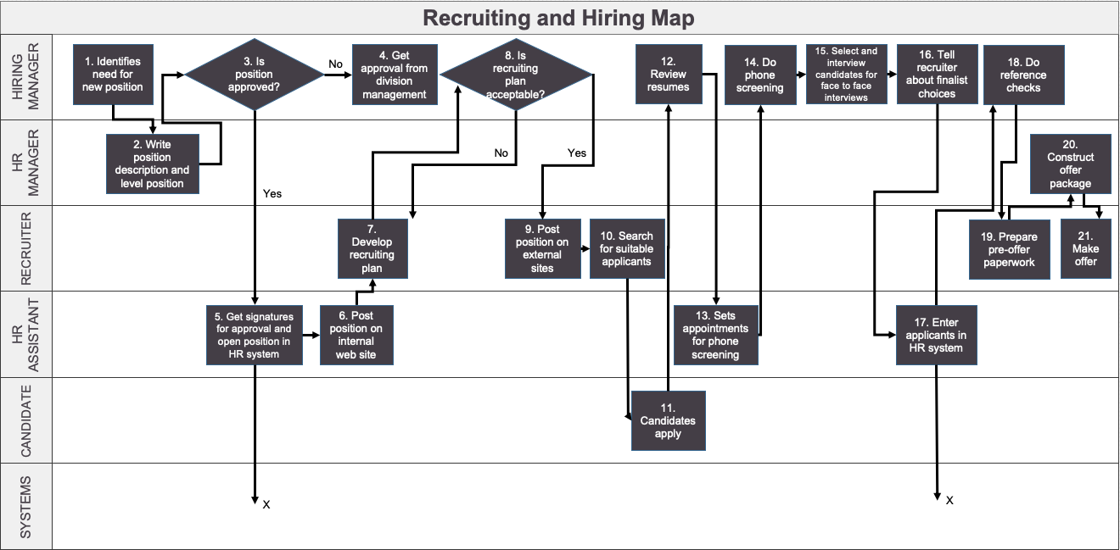
Swim Lane Diagram
Example

Slide 39
Swim Lane Mapping
Breakout
Map out how the process is currently done
Instructions
Using flip charts, build a swim lane chart wall. Create a row for each role currently involved in the process. Write the role on a large sticky note.
On sticky notes, write the activities of the process.
Place the sticky notes into the swim lanes as they currently occur.
Designate decision points by rotating sticky notes so that they are shaped like diamonds (as opposed to a square) and write the decisions on the sticky notes.
List and describe the process outputs on a flip chart and place at the end of the process.

Slide 40
Redesign the Activities
Breakout
Map out how the process is currently done
Step 2: Redesign the activities (and tasks if needed)
One approach: SCAMPERS
Simplifying—Activities or steps so that customer or organizational requirements aren’t over or under delivered (“what is the real reason for doing an activity?”)
Combining—Activities with another step or process.
Automating—Activities or processes by using technology to eliminate human handling and the potential for error.
Moving—Activities, materials, information to other areas internally or externally.
Making Parallel—Work so that it can be done at the same time rather than sequentially.
Eliminating—Activities, reviews, inspections, handoffs, delays, reports, approvals, filing, double handling of information or material—anything that is non-value added.
Rearranging—The physical layout, the order of the steps, or minimize the need to move or send.
Speed—Speed up the process. Kill dead or wait time. Do an activity more or less frequently.
Optional
Asking participants to use SCAMPERS as they complete their swim lane maps is one way to integrate process analysis, but process analysis could also be done before beginning process design, and different or additional tools could be used (see below).

Slide 41
Process Analysis: SCAMPERS
Simplifying – Activities or steps so that customer or organizational requirements aren’t over or under delivered (“what is the real reason for doing an activity?”)
Combining – Activities with another step or process.
Automating – Activities or processes by using technology to eliminate human handling and the potential for error.
Moving – Activities, materials, information to other areas internally or externally.
Making Parallel – Work so that it can be done at the same time rather than sequentially.
Eliminating – Activities, reviews, inspections, handoffs, delays, reports, approvals, filing, double handling of information or material—anything that is non-value added.
Rearranging – The physical layout, the order of the steps, or minimize the need to move or send.
Speed – Speed up the process. Kill dead or wait time. Do an activity frequently.
Optional
If needed, use one or any combination of the process analysis tools to help improve an existing process.
More tools and explanations can be found in the micro design toolkit.

Slide 42
Product Problem Analysis
Template
High
Impact
Low
Low
Frequency
High

Slide 43
Product Problem Analysis
Example
Key Product/ Service Problem | Probable Effects and Liabilities | Probable Impact | Frequency and Per Occurrence Cost | Annual Cost
Retail employee cannot adequately match colors | Employer not training Improper hire Improper equipment | Lost customer Material spoilage Lost revenue | $12.00 per gallon material X 200 occurrences annually $10.00 per gallon profit X 200 occurrences annually Assumed 20 lost customers per 200 events @ $50 per customer per year | $2,400 materials $2,000 profit $1,000 opportunity loss Total: $5,400

Slide 44
Product Problem Analysis
Example
Key Product/ Service Problem | Probable Effects and Liabilities | Probable Impact | Frequency and Per Occurrence Cost | Annual Cost

Slide 45
Cause and Effect Analysis
Example
EQUIPMENT
EQUIPMENT
Wear earplugs to sleep
Can’t hear alarm clock
Holds parties late into the night
Staying up to watch the playoffs
Pea under the mattress
Neighbors’ kid is home from college for the summer
Materials
Late to work 6
times in past month​
Drinking too much coffee
Nightly routine is disrupted by child getting up
Stressed about work project
Child scared of the dark
Watching horror movies right before bed
PEOPLE
METHODS/PROCESSES

Slide 46
Cause and Effect Analysis
Template
TEXT
TEXT
Text
Text
Text
Text
Text
Text
Text
Text
Text
Text
Text
Text
Text
TEXT
TEXT

Slide 47
Structure

Slide 48
Micro Design Drill-Down
Facilitation Roadmap (1 of 2)
Strategy
Work
Structure
Info. and
Metrics
STRATEGY IMPLICATIONS
PROCESS DESIGN
(Value Point Mapping)
ORGANIZING RATIONALE AND ORGANIZATION CHART
LINKAGE DESIGN
DECISION
RIGHTS
ORGANIZATION AND PROCESS METRICS
DESIGN PRINCIPLES AND CRITERIA
Purpose | Clarify what is most important to the customer and how the organization will meet those needs to deliver value. | Map how work will be performed to deliver value against the strategy. Capture how work will be performed across different parts of the organization. | Explore organizing themes along with their benefits and risks, and define organization structure options | Define mechanisms needed to enable cross-organization and cross-process interdependencies | Identify who will assume various levels of responsibility for making decisions and performing activities | Develop the input, in-process, output and impact metrics that will focus performance and behaviors
Output | Value Offering consisting of: Audience, Need, CHannel, Omits, and Revenue. | Maps that show the key activities, major outputs, tools/technology and intersections with roles/responsibilities needed to enable future work. | Organizing rationale used to analyze structure options, as well as organization charts (reporting relationships) | Linkage details about how these mechanisms work and who will ensure execution | Responsibility Chart (RACI or CIDER) | Metrics Design and Measurement Planner

Slide 49
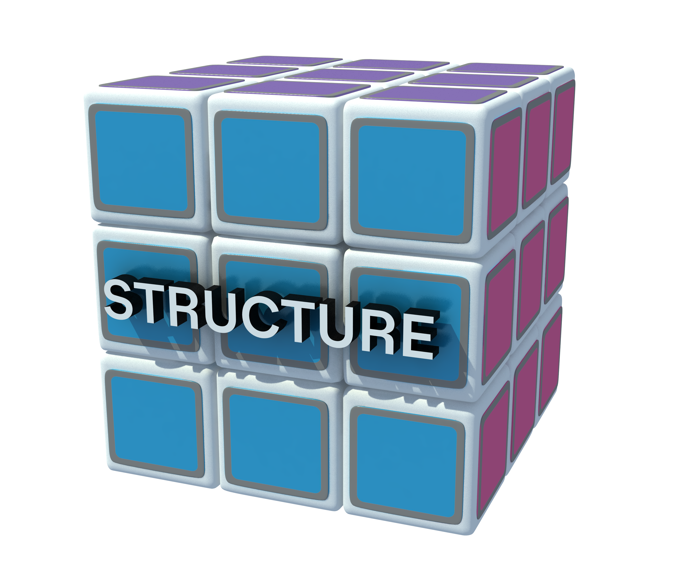
Mastering the Cube
Develop organization rationale to align how work is grouped or organized.
Define organization chart and clarify how the organization will work across boundaries.
Governance clarity.

Slide 50
Layering and Mixing of Organizing Rationales
Example: Security Solutions
L1 | CUSTOMER |  |  |  | FUNCTION
 | Residential & Small/Mid-sized Enterprise |  | Commercial |  | Guarding Delivery Marketing HR IT
L2 | GEOGRAPHY | FUNCTION | CUSTOMER | FUNCTION | FUNCTION
 | 1-5 Regions | Monitoring/Response Customer Service | Comm. Property Retailers Mining/Energy | Service/Installation Operations Contract & Bid Management | Product Management
L3 | FUNCTION | FUNCTION | DECISION MAKER/GEOGRAPHY | JOBS
 | Sales Technical Community Relations Branches | Operations Monitoring Guarding Training | Tier Decision Maker Regions | Engineers Project Managers
Organizing rationale is never strategically neutral at any level

Slide 51
Benefits and Risks of Organizing Rationale
 | Potential Benefits | Potential Risks
Product | Expertise grows around product. Clear accountability for product success. Career growth is around product. Higher customer satisfaction within a narrow range. Increased product innovation within narrow scope. | Duplication of resources. Reduced knowledge transfer across product groups. Reduced broader technology innovation and cross-product innovation. Functional career frustrations. Lower customer intimacy and satisfaction. Difficulty in redeploying talent.
Customer | Higher customer intimacy resulting in broader range of customer satisfaction. Clear accountability for customer satisfaction. Increased flexibility. Faster adaptation to customer changes. Higher margins. Higher revenues per customer group. | Duplication of resources/higher costs. Reduced knowledge transfer across customer groups. Career frustrations. More changes to processes. Trying to be too many things. Good health of best customers may drive focus on unimportant customers. Customers, rather than real innovation, drive change.
Function | Higher functional expertise. Career growth is around function. Easier career planning and movement. Career path matches external career paths resulting in higher career satisfaction. Greater functional control (ease of maintaining functional standards). Potential lower cost. | Poorly integrated output/less cross pollination. More rigid and less flexible work processes/less responsive and slower moving. Identification with function/more difficult to dev. business leaders. Accountability is less clear. Lower customer intimacy and satisfaction/less focus on product/customer.

Slide 52
Benefits and Risks of Organizing Rationale
 | Potential Benefits | Potential Risks
Process | Greater control of variances across boundaries. Ensures compliance/integrity. Greater alignment. Organization boundaries match point where value is created. Highly flexible. Career enhancer. | May be overly complex; matrix organization is often required. Process may not match professional or functional training. Specific and better management skills may be needed Higher cost. More politics. Performance management is more complex.
Geography | Closer to the customer. Better able to adapt to local requirements. Better match to language/culture. Easier to develop and maintain relationships. | Duplication of resources. Harder to control. Global customers are harder to integrate. Leverage learnings across geographies.
Channel | Higher intimacy with channel mechanisms, players, and customers/consumers. Career growth is around channel. Greater control and accountability around channel. Integration of diverse product or ANCHORs through channel. | Potential for resource redundancies. Potential for conflicts among channels. Less cross-pollination/coordination. More back-office coordination required. Competing channel objectives/ accountability for profitability is less clear. Functional groups/support areas may lose intimacy with customer.

Slide 53
Organizing Rationale
Example
L1 | Region |  |  |  | Business/Product Group |  |  |  | Functions Shared Globally
 | Region 1 | Region 2 | Region 3 | Region 4 | Product 1 | Product 2 | Product 3 | Product 4 | Function 1 | Function 2
L2 | Sub-Regions |  | Functions Shared within Regions |  | Divisions / BU |  | Functions Shared within Groups |  | Functions Shared Globally
 | Subregions 1-5 |  | Function 1 |  | Divisions 1-5 |  | Function 1 Function 2 |  | Function 1 Function 2
L3 | Country |  |  |  | BU / SBUs |  | Functions Shared within BUs/SBUs | Functions Shared within BUs/SBUs
 | Example Country |  |  |  | Business Unit 1 |  | Function 1 | Post market reporting Internal PCN triage

Slide 54
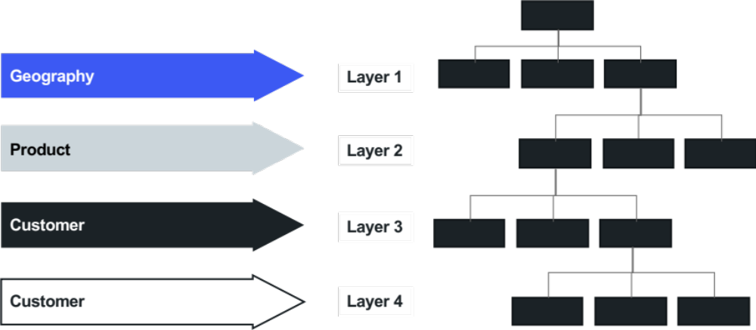
Organizing Rationale Leads to Organization Chart

Slide 55
Organizing Rationale
Breakout
Revisit the organizing rationale from macro design, if available.
Use the ANCHOR, other strategy and direction that you have been given, and your process design to redesign the organizing rationale within your scope of influence and develop the organizing rationale at lower levels of the organization.
Things to keep in mind…
  We will be doing several iterations of this exercise.
  We will vote on what options we like best.
  In between each iteration, you should “steal” ideas from other teams to enhance your thinking and options.
  We will seek agreement for layers 2-3 before moving to lower layers of the organization.

Slide 56
Organizing Rationale
Template
L1
L2
L3
Benefits (upsides) | Risks (downsides)

Slide 57
Organizing Rationale Benefits and Risks
Template
Benefits | Risks

Slide 58
Building Out the New Design
A. Draw the Boxes
B. Define Functional Definitions
Geography
Tier One
Product
Tier Two
Customer
Tier Three
Create branding assets | Build product marketing plans Conduct comp. analysis | Support sales team with custom requests
C. Flag New/Changed Roles
D. Design Linkages and Role Definitions
New/Changed role
(Greater than 50% Change)
Same/Minor Changes
(Less Than 50% Change)

Slide 59
Organizing Rationale
Breakout
Identify the primary areas (groups, departments, or sub-organizations) for lower levels in the organization
Ensure alignment between process roles and the organization chart
Ensure optimal allocation of work to the right levels in the organization and streamline spans of control
Things to keep in mind
  We will be doing several iterations of this exercise.
  We will vote on what options we like best.
  In between each iteration, you should "steal" ideas.
  from other teams to enhance your thinking and options.
  We will seek agreement for layers 2-3 before moving to lower layers of the organization.

Slide 60
Organization Chart
Example
Leader
Individual
Contributor
Head of Commercial
Head of Customer Service
Head of Marketing
Head of Finance
Dev Innovation/ Prototyping
Business Analyst
Dev Innovation/ Prototyping
Business Analyst
BA Innovation/ Prototyping
Dev
Dev
Business Analyst
Business Analyst
Business Analyst
Business Analyst
Dev
Dev
Dev
Dev
Business Analyst
Business Analyst
Business Analyst
Business Analyst
Dev
Dev
Dev
Dev
L2
L3
L4

Slide 61
Management / Work Levels and Span of Control
Management / Work Levels
The number of hierarchical reporting relationships that exist between the CEO and lowest level individual contributor in an area, department, division or company. Ensuring that each level of the organization has a clear organizational accountability will enhance decision making speed and organization effectiveness.
Span of Control (SOC)
The number of subordinates who report directly to a single manager or supervisor.
What management and work levels are needed and what is the rationale / role for each?​
What is the right span of control?​

Slide 62
Impact of Management / Work Levels on Business Value
Management Work | Innovation Focus | Time Horizon
Global Transformational Work | Global Industry Structure Corporate Citizenship | 7+ years
Transformational Work | Business Model Innovation | 5-10 years
Breakthrough Work | New Product/Service/ New Market Innovation | 3-5 years
Systematic Work | Value Stream and/or Process Innovation | 1-2 years
Situational Work | Quality and Continuous Improvement | 3 mos to 1 year
Procedural Work | Executional Excellence | 1-3 months
Strategic System
Focused on Ensuring Future
Growth
Value
Coordinating System
Focused on Delivering Current Value
Operating System
The design of work, coordinated with the number of management levels,
drives innovation accountability and thus enterprise value.​
Adapted from Organizational Capital Partners

Slide 63
Importance of Clarifying Management / Work Layers
Management Work | Innovation Focus | Organization Structure
 |  | Gaps | Jam-Ups | Optimal
Transformational Work | Business Model Innovation
Breakthrough Work | New Product/Service/ New Market Innovation
Systematic Work | Value Stream and/or Process Innovation
Situational Work | Quality and Continuous Improvement
Higher mgmt
level
Lower mgmt level
Missing key levels of Work
Strategy execution challenges
Customer satisfaction/ loyalty challenges
Over-layered
Slow decision making
Excess costs
Lack of role clarity
Aligned, adaptive, resilient organization
High performance organization
Adapted from Organizational Capital Partners

Slide 64
Spans of Control Considerations
A lower span of control ratio is appropriate when…
A higher span of control ratio is appropriate when…
Work is unpredictable
Work is highly predictable
Lots of work
coordination required
Minimal work
coordination required
Low skill
level of workers
High skill
level of workers
Limited self-management experience
Significant self-
management experience
Competitive/ competitive enabling work
Necessary/
compliance work
Low capacity
to do work
High capacity
to do work
Working manager (Individual contributor)
Coaching manager (Management only)
High complexity,
high risk work
Low complexity,
low risk work
Different goals/
measures
Similar goals/
measures
Multiple locations/ geographies
Single location/
geography

Slide 65
Span of Control Assessment
Low Ratio High
 | Never | Rarely | Sometimes | Most of the time | Always
Work comes in at a steady pace
Work assignments are straightforward, easy to understand and complete
Workers can do significant amounts of work
 | All | Many | Some | A Few | None
Many workers are learning their roles
Many workers lack the desired skills to perform the work
 | No experience | A little experience | Some experience | Experience | Lots of experience
Workers have experience in directing their own work activities
 | None | A few | Some | Many | A Lot
Workers have skills in working on teams
 | Constant | Frequent | Periodic | Infrequent | Ad hoc
Work activities require constant supervision for accurate and timely completion

Slide 66
Span of Control Assessment, Continued
Low Ratio High
 | Never | To a small extent | Sometimes | Mostly | Always
Role is focused and specialized allowing for high-levels of productivity and repetitiveness
Manager’s role is primarily one of managing, coaching, developing, and leading
 | All | No | To a small extent | Average | To a large extent
Technology and facilities are conducive to work being performed and enable sharing, collaboration, production, etc.
 | Always | Most of the time | Sometimes | Rarely | Never
Failure to perform work as specified can expose organization to risk/sanction
 | Completely | To a large extent | Mix | To a small extent | No
Work is located in multiple locations
 | Almost all of it | Some of it | Mix | A small portion | Most is Necessary or Compliance
Work being performed is primarily competitive or competitive enabling work

Slide 67
Organization Chart Changes
Example
Level 5: Breakthrough
Work
Head of
Commercial
SOC: 1:7
Level 4: Systemic
Work
Head of Customer Type 1
Head of Marketing Fulfillment
Head of Customer Type 2
Head of Customer Type 3
Head of Business Services
Head of Customer Service
Head of Commercial Ops
Head of IT
Head of New Products
Head of Demand
Head of US
Head of Demand
Head of Customer A Sales
Head of Marketing Fulfillment
Head of Cust. Exp. Quality
Head of Customer Type 1 Finance
Head of Product A
Level 3: Situational
Work
Head of Fulfillment
Head of US
Head of Fulfilment
Head of Customer A Marketing
Head of Analytics
Head of Ops / Tech.
Head of Customer Type 2 and 3 Finance
Head of Product B
Head of On-going Loyalty
Head of On-going Loyalty
Head of Customer B Sales
Head of Dist / Logistics
Head of Strategic Services
Head of Coordinating Planning
Head of Innovation
Head of Marketing
Head of Marketing
Head of Customer B Marketing
Head of Training
Head of CS Inst.
Head of Demand Planning
Head of Strategic Partner-ship
Head of Ongoing Loyalty
Head of Sales Ops
SOC: 1:4.4
Head of Fulfillment
Head of IT

Slide 68
Functional Dept / Organization Definition
Breakout
Identify the primary areas (groups, departments, or sub-organizations) for lower levels in the organization
Ensure alignment between process roles and the organization chart
Ensure optimal allocation of work to the right levels in the organization and streamline spans of control
Things to keep in mind
  We will be doing several iterations of this exercise.
  We will vote on what options we like best.
  In between each iteration, you should "steal" ideas.
  from other teams to enhance your thinking and options.
  We will seek agreement for layers 2-3 before moving to lower layers of the organization.

Slide 69
Organization Chart with Work Responsibilities
Example
L2
Head of
Customer Type 1
L3
Head of
Demand
Head of
Fulfillment
Head of
On-going Loyalty
Head of
Supply
What is the role/group responsible for (work activities list or summary) | Drive communication through public affairs Develop consumer marketing of customer experience, development and execution Create role of patient champion (research, insights, focus) Strengthen e-marketing | Manage consumer marketing/DTC Creating broad customer awareness and ongoing engagement Become a direct-to-consumer company Manage consumer brand | Design CRM (consumer relationship marketing) Drive sales for incoming consumer calls Manage CRM system Market on social medial Analyze VOC data Optimize customer experience | Build DTP (Rx) distribution infrastructure Develop customer training online tools (training, solutions, VPMs/self help)

Slide 70
Organization Chart with Work Responsibilities
Example
L2
Head of
Customer Type 1
L3
Head of
Demand
Head of
Fulfillment
Head of
On-going Loyalty
Head of
Supply
Key Purpose | Text | Text | Text | Text
What is the role/group responsible for (work activities list or summary) | Drive communication through public affairs Develop consumer marketing of customer experience, development and execution Create role of patient champion (research, insights, focus) Strengthen e-marketing | Manage consumer marketing/DTC Creating broad customer awareness and ongoing engagement Become a direct-to-consumer company Manage consumer brand | Design CRM (consumer relationship marketing) Drive sales for incoming consumer calls Manage CRM system Market on social medial Analyze VOC data Optimize customer experience | Build DTP (Rx) distribution infrastructure Develop customer training online tools (training, solutions, VPMs/self help)

Slide 71
Organization Chart with Work Responsibilities
Template
LX
Head of X
Head of X
Head of X
Head of X
Head of X
Head of X
Head of X
LX
Key Purpose
What is the role/group responsible for (work activities list or summary)

Slide 72
Organization Chart
Example
Leader
Individual
Contributor
Head of Commercial
Head of Customer Service
Head of Marketing
Head of Finance
Dev Innovation/ Prototyping
Business Analyst
Dev Innovation/ Prototyping
Business Analyst
BA Innovation/ Prototyping
Dev
Dev
Business Analyst
Business Analyst
Business Analyst
Business Analyst
Dev
Dev
Dev
Dev
Business Analyst
Business Analyst
Business Analyst
Business Analyst
Dev
Dev
Dev
Dev
L2
L3
L4

Slide 73
Organization Chart
Template
Leader
Individual
Contributor
X
X
X
X
X
X
X
X
X
X
X
X
X
X
X
X
X
X
X
X
X
X
X
X
X
X
X
LX
LX
LX

Slide 74
Functional Dept / Organization Definition
Breakout
Identify the primary areas (groups, departments, or sub-organizations) for lower levels in the organization
Ensure alignment between process roles and the organization chart
Ensure reasonable spans of control
Capture a summary description of the purpose, outcomes, responsibilities, and decisions of the primary areas in the new organization
Flag new and changed roles/positions
Things to keep in mind
We will be doing several iterations of this exercise.
We will vote on what options we like best.
In between each iteration, you should “steal” ideas from other teams to enhance your thinking and options.

Slide 75
Organization Chart
No Change in role
Example
Changed Role (>50% change)
Leader
Individual
Contributor
New Role
L2
Head of Commercial
Head of Customer Service
Head of Marketing
Head of Finance
Dev Innovation/ Prototyping
Business Analyst
Dev Innovation/ Prototyping
Business Analyst
BA Innovation/ Prototyping
Dev
Dev
Business Analyst
Business Analyst
Business Analyst
Business Analyst
Dev
Dev
Dev
Dev
Business Analyst
Business Analyst
Business Analyst
Business Analyst
Dev
Dev
Dev
Dev
L3
L4

Slide 76
Micro Design Drill-Down
Facilitation Roadmap (1 of 2)
Strategy
Work
Structure
Info. and
Metrics
STRATEGY IMPLICATIONS
PROCESS DESIGN
(Value Point Mapping)
ORGANIZING RATIONALE AND ORGANIZATION CHART
LINKAGE DESIGN
DECISION
RIGHTS
ORGANIZATION AND PROCESS METRICS
DESIGN PRINCIPLES AND CRITERIA
Purpose | Clarify what is most important to the customer and how the organization will meet those needs to deliver value. | Map how work will be performed to deliver value against the strategy. Capture how work will be performed across different parts of the organization. | Explore organizing themes along with their benefits and risks, and define organization structure options | Define mechanisms needed to enable cross-organization and cross-process interdependencies | Identify who will assume various levels of responsibility for making decisions and performing activities | Develop the input, in-process, output and impact metrics that will focus performance and behaviors
Output | Value Offering consisting of: Audience, Need, CHannel, Omits, and Revenue. | Maps that show the key activities, major outputs, tools/technology and intersections with roles/responsibilities needed to enable future work. | Organizing rationale used to analyze structure options, as well as organization charts (reporting relationships) | Linkage details about how these mechanisms work and who will ensure execution | Responsibility Chart (RACI or CIDER) | Metrics Design and Measurement Planner

Slide 77
Value Point Map Linkages
Example
INPUTS​
Receive prioritized and approved and are assigned, scheduled, and framed​.
1 – Initiated
2 – Planned
3 – Built
4 – Executed / Deployed
5 –Closed
OUTPUTS​
Project deployed to production​.
Activities:
Define full project team (SMEs, business process consultant, C.H).
Define project charter.
  Agile or waterfall?
Activities:
Onboard project team.
Define requirements high level.
Buy or build?
Continue.
Vendor needed?
If NO, value point 3.
If YES, continue.
Complete SEM process and document.
Vendor needed?
If NO, Return to high level requirements or vendor.
If YES, continue.
Negotiate and onboard contracts – as needed.
Define system monitoring (performance and security).
Define training plan, as needed.
Define change management plan, as needed.
Follow release management process – including asset management plan.
Activities:
Follow agile or waterfall methodology.
Develop solution – environment build and deploy – dev. test, production.
Define test plans – dev, QA, UAT.
Test Solution – dev, QA, UAT.
Conduct code review – as needed.
Business user sign off?
If YES, continue to Executed or agile process.
If NO, Activity 2.
Activities:
Document process by BPC.
Deploy change management plan, as needed.
Deploy release notes – as needed.
Execute training.
Follow change control process.
Deploy system and process.
Deploy system monitoring.
Provide initial support.
Activities:
Hand-off to service desk tier 3.
Initiate metrics tracking.
Update asset management system.
Document lessons learned.
Linkage:
Project management link to portfolio management for statusing.
Key roles involved in the process are color coded:
Metrics
Input
Project prioritization and adherence
Agile velocity
In process
Cycle time
Backlog adherence
Code quality
Output
Business system availability
Epic release schedule met
Project Manager
Business Analyst
Release Engineer / Dev Ops Engineer
Support
Change Management (includes Framing Support)
Work Team
Developer
BPC
Engineer
Tools and Technologies
Template for charters
Template for requirements (business rules, system and functional requirement)
Template for HLD (high level document)
Metrics document template
Waterfall and agile methodologies defined

Slide 78
Linking Mechanisms - Cube View
A. Work
Process / Technology / Policies
SOPs, workflow improvements, and automation connect teams across organizational silos
B. Structure and Governance
Informal Contacts / Co-location
Lunch chats, open offices, and spontaneous talks foster teamwork beyond formal structures.
Teams / Committees / Forums / Meetings
Committees, stand-ups, and cross-functional teams drive structured collaboration.
Dual Reporting / Matrix
Dual reporting structures, like matrix management, formally connect employees across functions, regions, and projects for greater collaboration. They are difficult to implement but very effective when done well.
F. Leadership and Culture
Values, operating principles, and norms can be among the most effective informal linking forces but are difficult to change.
Leadership alignment workshops foster shared understanding in executive teams
E. Continuous Alignment
Feedback loops
Supplier scorecards, pulse surveys feedback analytics, project reviews, and Gemba walks enhance continuous improvement through real-time insights.
C. Information and Metrics
Shared Goals and Metrics
OKRs, dashboards, and shared goals align teams through measurable performance metrics.
D. People and Rewards
Job expectations and career paths
Liaison roles, job rotation, and horizontal career paths create shared experiences and mutual understanding
Learning & Knowledge Management
Training, Wikis, and mentorship drive knowledge sharing and continuous learning.

Slide 79
Linking Mechanisms – List view
Linkage Type | How They Reduce the Risk of Silos and Foster Connection | Examples
Informal Contacts / Co-location | Encourages spontaneous collaboration and knowledge sharing, reducing reliance on rigid processes. | Employees collaborating over lunch Spontaneous problem-solving chats
Learning & Knowledge Management | Training conveys knowledge of new processes, skills, customer requirements, and more. Mentorship nurtures know-how. Knowledge management captures institutional knowledge, preventing repeated mistakes and knowledge loss during restructuring. | Process and skills training Internal knowledge wikis Mentorship programs
Process / Technology | Workflow improvements and automation connect teams across organizational silos. Automation can enhance collaboration and ensure data consistency across the organization. | Workflow maps and SOPs Cloud-based ERP systems, integrated CRM platforms AI-driven dashboards
Feedback loops | By embedding continuous improvement linkages, companies create a culture where improvement is a natural and ongoing part of operations. | Gemba walks After-action project reviews Customer, supplier, and employee feedback analytics Organizational alignment surveys
Shared Goals / Metrics / SLAs | Create alignment across teams and departments, ensuring consistency in objectives, policies and performance. | OKRs (Objectives & Key Results) Performance dashboards and scorecards Shared performance goals
Job expectations and career paths | Job and career path design foster mutual understanding when they embed formal responsibility for working and sharing experiences across the organization. | Liaison roles Job rotation Horizontal career tracks
Forums / Meetings / Teams / Committees | Provides structured discussions to align cross-functional teams and resolve issues quickly. Avoid relying on meetings to solve all linking needs as they are time-consuming. | Weekly stand-up meetings Cross-functional task forces Process management teams Communities of practice
Dual-reporting (Matrix) | Enhances flexibility in decision making but requires clear accountability | Product managers reporting to marketing & R&D Regional and functional reporting structures Employees assigned to multiple projects
Culture | Fosters alignment and shared understanding. Culture can a powerful linking force, but when it impedes the right linkages, it is difficult to change. | Values, operating principles, norms Leadership alignment workshops
Linking effectiveness

Slide 80
Linkage Planner Example
Operations Example and IT Example
Organization Structure Risk | Recommended Linking Mechanism | Linking Mechanism Details | Implemen-tation Owner | Resource/ Support Needs
Operations Example Link Manufacturing Operations with Support Functions for Strategic Planning | Weekly Meetings Monthly Performance Review Meetings Quarterly Strategic Planning Meetings | Heads of Support, Regulatory Affairs, Operations, and Technical will meet as follows: Weekly—30 min or less review of current priorities; agree to top priorities to hit site goals. Monthly—60 min review of month’s performance and gaps; make adjustments resource allocation across the site. Quarterly—120 min review of project completion, financials, and previous trade-off decisions. Set priorities/decision making principles for next quarter. | Plant manager
IT Example Link IT Methodology and Standards group with all of IT for education and feedback | Community of practice | CoP will be attended by Software Development Lifecyle Committee, Continuous Deployment, DevSecOps, Agile/ product centric – will share standards that are prescriptive, repeatable, and also how to’s, etc | IT Methodology and Standards Lead
 | Automated compliance dashboards | Dashboards will measure progress and report deviations | IT Methodology and Standards Lead
 | Training and certification | IT Group will connect to IDPs (Individual Development Plans), Percipio, L&D for training development and delivery | IT Methodology and Standards Lead

Slide 81
Linkage Detail Planner
Breakout
Begin planning how to address the linkage needs you’ve identified by filling out the template on the next slide.
Things to keep in mind
  Use the Linkage Capture template created in Macro/Micro design
  Validate and clarify the Linkage Planning Information
  Identify the linkage detail needed to resolve the risks
  Add additional notes about others' resources or support needed for each linking mechanism.

Slide 82
Internal Interdependencies
Breakout
Identify key interdependencies
Things to keep in mind…
  Internal refers to groups inside of the group we are redesigning, not to the enterprise

Slide 83
Internal Interdependencies
 |  | Giving Group
 |  | Group A | Group B | Group C | Group D | Group E | Group F
Receiving Group | Group A
 | Group B
 | Group C
 | Group D
 | Group E
 | Group F

Slide 84
External Interdependencies
Breakout
Identify external interdependencies
Things to keep in mind…
External refers to groups outside of the group we are redesigning

Slide 85
External Interdependencies
 | Stakeholders
 | External Group 1 | External Group 2 | External Group 3 | External Group 4 | External Group 5
Our Organization

Slide 86
Linkages
Breakout
Begin planning how to address the linkage needs you’ve identified
by filling out the template on the next slide.
Things to keep in mind…
Column 1: Identify linkage needs from the process design (your Value Point Map) and other sources. If needed, prioritize to identify the critical few.
Columns 2 and 3: Select / develop the appropriate linking mechanism and write it in the second column. In the third column, plan the specific details.
Column 4: Assign an owner for the implementation of each linkage.
Column 5: Add additional notes about others' resources or support needed for each linking mechanism.

Slide 87
Linkage Planner
Example
Linkage Need (Downsides or Risks to Mitigate or Overcome) z | Linkage Design (Linking Mechanisms) | Linkage Details | Implementation Owner | Resource/ Support Needs
Strategic plan development and articulation of trade-offs | Weekly Meetings Monthly Performance Review Meetings Quarterly Strategic Planning Meetings | Heads of Support, Regulatory Affairs, Operations, and Technical will meet as follows: Weekly—30 min or less review of current priorities; agree to top priorities to hit site goals. Monthly—60 min review of month’s performance and gaps; adjustments made to resource allocation across the site. Quarterly—120 min review of project completion, financials, and revisit previous trade-off decisions and set priorities/decision making principles for next quarter. | Plant manager
List the group(s) or people/role involved and indicate who should be on point to own the execution of the linkage (makes sure it happens).
Interdependency or downside to mitigate / overcome.
Provide enough detail so we understand the possible interdependency.
Refer to Linkage Menu slide for ideas of the categories; only use those that apply.
Provide details on how the linkage is supposed to work.

Slide 88
Linkage Planner
Template
Linkage Need (Downsides or Risks to Mitigate or Overcome) z | Linkage Design (Linking Mechanisms) | Linkage Details | Implementation Owner | Resource/ Support Needs

Slide 89
Micro Design Drill-Down
Facilitation Roadmap (1 of 2)
Strategy
Work
Structure
Info. and
Metrics
STRATEGY IMPLICATIONS
PROCESS DESIGN
(Value Point Mapping)
ORGANIZING RATIONALE AND ORGANIZATION CHART
LINKAGE DESIGN
DECISION
RIGHTS
ORGANIZATION AND PROCESS METRICS
DESIGN PRINCIPLES AND CRITERIA
Purpose | Clarify what is most important to the customer and how the organization will meet those needs to deliver value. | Map how work will be performed to deliver value against the strategy. Capture how work will be performed across different parts of the organization. | Explore organizing themes along with their benefits and risks, and define organization structure options | Define mechanisms needed to enable cross-organization and cross-process interdependencies | Identify who will assume various levels of responsibility for making decisions and performing activities | Develop the input, in-process, output and impact metrics that will focus performance and behaviors
Output | Value Offering consisting of: Audience, Need, CHannel, Omits, and Revenue. | Maps that show the key activities, major outputs, tools/technology and intersections with roles/responsibilities needed to enable future work. | Organizing rationale used to analyze structure options, as well as organization charts (reporting relationships) | Linkage details about how these mechanisms work and who will ensure execution | Responsibility Chart (RACI or CIDER) | Metrics Design and Measurement Planner

Slide 90

Decision Rights (RACI)
Example
Responsible: Person who performs an activity or and is accountable for delivery.
Approval: Person who approves under certain thresholds and has Yes/No/Veto.
Consulted: Person who needs to provide feedback and contribute to the activity.
Informed: Person who needs to know of the decision or action.
Record assumptions
Decision/ Responsibility | Business Leader | Process Owner | Functional Leader | Manager | Assumptions
Develop budgets | R, A | I | C | I | Functional leaders will have at least two weeks to consult.
Establish performance goals | R | C | C |  | Business leaders will cascade goals to individual contributor level.
Establish pricing strategy | R, I |  | C | I | Pricing strategy must achieve no less than 10% ROI.
Execute pricing strategy | A, C | R | C |  | Process owner may adjust pricing without permission as long as it is within 5% of target.

Slide 91
Decision Rights (RACI)
Example
 | Roles:
Decision: | Head of US Quality Operations | Head of Analytical Operations | Head of Corporate Quality | Head of New Product and Technical Support | Head of Quality Business Planning and Programs | SVP of Quality | QLT | EQLT | Finance | Supply Chain | IT
Assure GMPs | R
Disposition decision | R |  | C |  |  | C |  |  | I | I
Define/decide system for KM/data management | C | C | R |  |  |  | A |  |  |  | C
Define and manage global directives (regulatory interpretation) | C | C | R | C |  |  | A | I |  | C | C
Utilization of global budget | C | C | C | C | R | A | C | I | C | I | I
Set quality strategy |  |  |  |  |  | A | R | C | C | C | C
Facilitate strategic planning process |  |  |  |  | R
Defining goals and priorities |  |  |  |  |  | A | R | C | C | C | C
Set expectation for data availability | C | R |  |  |  |  |  |  |  | C
External vs. internal testing |  | R |  |  |  |  | I |  | I
New technology implementation strategy (Device) | C |  |  | R
New technology implementation strategy (Process) | C | C |  | R |  |  |  |  |  | I
R = Responsible A = Approve C = Consulted I = Informed

Slide 92
Decision Rights (RACI)
Breakout
Define work process roles and responsibilities or in defining decision rights by identifying a scenario, key steps, decisions and roles and then determine responsibilities.
Things to keep in mind…
Responsible: person who performs an activity or does the work.
Approval: person who is ultimately accountable and has Yes/No/Veto.
Consulted: person that needs to feedback and contribute to the activity.
Informed: person that needs to know of the decision or action.

Slide 93
Decision Rights (RACI)
Template
 | Role:
Decision:
R = Responsible A = Approve C = Consulted I = Informed

Slide 94
Information and Metrics

Slide 95
Micro Design Drill-Down
Facilitation Roadmap (1 of 2)
Strategy
Work
Structure
Info. and
Metrics
STRATEGY IMPLICATIONS
PROCESS DESIGN
(Value Point Mapping)
ORGANIZING RATIONALE AND ORGANIZATION CHART
LINKAGE DESIGN
DECISION
RIGHTS
ORGANIZATION AND PROCESS METRICS
DESIGN PRINCIPLES AND CRITERIA
Purpose | Clarify what is most important to the customer and how the organization will meet those needs to deliver value. | Map how work will be performed to deliver value against the strategy. Capture how work will be performed across different parts of the organization. | Explore organizing themes along with their benefits and risks, and define organization structure options | Define mechanisms needed to enable cross-organization and cross-process interdependencies | Identify who will assume various levels of responsibility for making decisions and performing activities | Develop the input, in-process, output and impact metrics that will focus performance and behaviors
Output | Value Offering consisting of: Audience, Need, CHannel, Omits, and Revenue. | Maps that show the key activities, major outputs, tools/technology and intersections with roles/responsibilities needed to enable future work. | Organizing rationale used to analyze structure options, as well as organization charts (reporting relationships) | Linkage details about how these mechanisms work and who will ensure execution | Responsibility Chart (RACI or CIDER) | Metrics Design and Measurement Planner

Slide 96

Mastering the Cube
Input | In-Process | Output | Impact
Metric 1 Metric 2 | Metric 1 Metric 2 | Metric 1 Metric 2 | Metric 1 Metric 2
Behavior1 Behavior 2 | Behavior1 Behavior 2 | Behavior1 Behavior 2 | Behavior1 Behavior 2
Measures which indicate the effectiveness of the organization in delivering its strategy.

Slide 97
What to Measure?
Concept Development and Marketing Example
Final Outputs
What the
activities
produce
Final Impact
The ultimate effect
on stakeholders,
customers,
and employees
Input
Information,
capital,
material
Process
In-process work activities/behaviors
Market data
Census
Corporate performance data
Researching
Analyzing
Concepting
Testing
Budgeting
Concepts
Budgets
Plans
Number of Customers
Cash
Brand strength
Customer retention

Slide 98
What to Measure?
Concept Development and Marketing Example
Final Outputs
What the
activities
produce
Final Impact
The ultimate effect
on stakeholders,
customers,
and employees
Input
Information,
capital,
material
Process
In-process work activities/behaviors
Input measures
Provide data about the materials, capital and information you use to produce results or outputs. Common examples of input measures are assets, information, equity, budgets, and raw materials.
In-process or “activity” measures
Tells about what is going on inside work processes. In-process measures are the things you do (activities and behaviors) that use inputs and produce the direct outputs. Number of calls received, number of hours worked, number of "X" activities completed are examples of activities measures.
Final output measures
Provides data about the product/service attribute qualities (product characteristics, delivery time), flexibility (range of offerings, response time), and innovation (number of, or percentage of new products), etc. Final output measures may also be the input measure for other processes down the line.
Final impact measures
Provides data on how customers, employees, shareholders, community, and other stakeholders are impacted by the direct outputs of the organization. In a hospital, patients are impacted by hospital care. The impact measures capture the ultimate effect of the work such as recoveries, death, revenue, or profitability.

Slide 99
Metrics Design
Identify the key behaviors that you want to drive using metrics. (Measures/information → desired behaviors)
Develop the input, in-process, output and impact metrics that will enable your process to support your strategy.
Input | In-process (Activity) | Output | Impact
The measures above will drive what behaviors? (capture the behaviors below)

Slide 100
Process Measures
Breakout
Instructions
Determine one input, in-process, output, and impact measure (Use the template provided)
Identify the desired behaviors each is intended to drive/influence
Prioritize the metrics
Complete a measurement planner for the highest priority metrics
Input | In-process (Activity) | Output | Impact
The measures above will drive what behaviors? (capture the behaviors below)

Slide 101
Metrics Design
Template
Input | In-process (Activity) | Output | Impact
The measures above will drive what behaviors? (capture the behaviors below)

Slide 102
Measurement Planner
Template
Measurement Planner for _____________ process
Key Metric | Behavior Targeted | Target | Baseline | Who Develops Metric? | How collected & reported? | Frequency? | Implementation Issues?

Slide 103
People & Rewards

Slide 104
Micro Design Drill-Down
Facilitation Roadmap (1 of 2)
Strategy
Work
Structure
Info. and
Metrics
STRATEGY IMPLICATIONS
PROCESS DESIGN
(Value Point Mapping)
ORGANIZING RATIONALE AND ORGANIZATION CHART
LINKAGE DESIGN
DECISION
RIGHTS
ORGANIZATION AND PROCESS METRICS
DESIGN PRINCIPLES AND CRITERIA
Purpose | Clarify what is most important to the customer and how the organization will meet those needs to deliver value. | Map how work will be performed to deliver value against the strategy. Capture how work will be performed across different parts of the organization. | Explore organizing themes along with their benefits and risks, and define organization structure options | Define mechanisms needed to enable cross-organization and cross-process interdependencies | Identify who will assume various levels of responsibility for making decisions and performing activities | Develop the input, in-process, output and impact metrics that will focus performance and behaviors
Output | Value Offering consisting of: Audience, Need, CHannel, Omits, and Revenue. | Maps that show the key activities, major outputs, tools/technology and intersections with roles/responsibilities needed to enable future work. | Organizing rationale used to analyze structure options, as well as organization charts (reporting relationships) | Linkage details about how these mechanisms work and who will ensure execution | Responsibility Chart (RACI or CIDER) | Metrics Design and Measurement Planner

Slide 105
Micro Design Drill-Down
People and Rewards
Culture and
Leadership
Scenario
Testing
Micro to
Journey Bridge
STRATEGIC CULTURAL BEHAVIORS AND LEADERSHIP PRACTICES
USE CASE TESTING
BRIDGE TO REALIZATION
ROLE
DESIGN
STAFFING
DESIGN PRINCIPLES AND CRITERIA
Purpose | Describe roles and responsibilities for new/changed positions | Identify staffing drivers and/or ratios to rationalize the numbers of roles needed for key processes or functions | Identify key strategic behaviors or leadership practices that need to change – and how – to deliver the strategy and design intent | Facilitate stakeholder testing of design choices in real-life scenarios to identify gaps, risks or integration needs | Develop high-level plans to transition to and realize the recommended alignment choices
Output | Role profiles | Staffing estimates and assumptions | Strategic cultural behaviors and leadership practices chart | Use cases that demonstrate how key actions and decisions will work | High-level transition/implementation plan

Slide 106
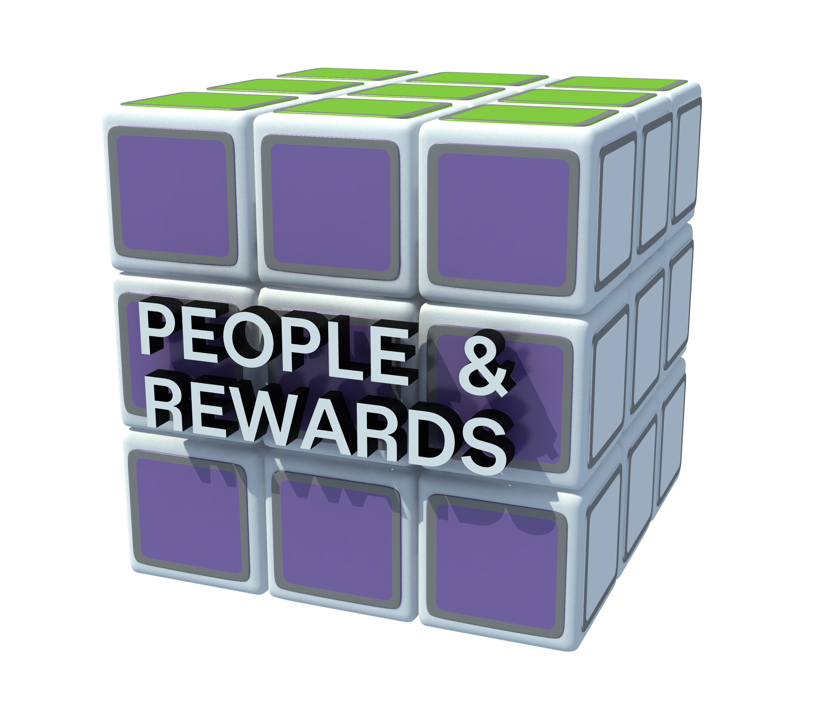
Mastering the Cube
People and Rewards Outcomes
Description of newly designed leadership roles.
Staffing estimates and assumptions

Slide 107
Roles—New or Changed
Level 2 Roles | Level 3 Roles | Level 4 Roles | Level 5 Roles
Rates / Finance Ops | Finance Business Partner FA and Decision Support | Finance/Rates Analyst
Accounting | Rates Support | Revenue Requirements Regulatory Reporting General | Analyst
 | Tax
 | Accounting / External Reporting | General Accounting Accounting Research External Reporting | Accountant
 | Budgeting/ Mgmt Reporting | Budgeting Analyst Internal Reporting | Analyst Revenue Analytics
Treasury | Benefits Strategies Analyst | Insurance Coverage Optimization
Audit
IR

Slide 108
Role Profiles
Breakout
In small groups:
Review the organization structure and identify, if you haven’t already:
    New roles
    Changed roles
For new / changed roles, develop the role definition
Share your draft role definition with the next group who will make additions/changes (watch for overlaps and ambiguities with other roles.)
Repeat the process until the role definition returns to the original authors.
The original authors make the final changes.

Slide 109
Role Profile
Example: Head of Sales
Role Name: | Head of Sales
Reports to (role): | President
Key Stakeholder Relationships: | Co-owns (with salesman) relationship of top revenue producing accounts. Owns relationship with marketing support organizations.
Key Linkages: | [linkage: interactions/communication/coordination with other areas within the organization] Regularly meets with operations to discuss improvements and opportunities. Runs think tank meeting with all other leaders to drive innovation. Tracks and reports downward metrics shared by logistics and sales.
Key Decision Rights: | [list the key decisions this position is responsible for making] Commission structure. Work schedules of sales staff. Margin boundaries for sales staff to work within.
Major Responsibilities: |  | Expected Results:
Train sales team on ongoing basis. Management review meetings on monthly basis with sales reps. Motivate and drive sales goals. Hitting sales goals for company. Hire sales reps. |  | Increase sales year over year by 10%. Increase sales per client by 200% within 3 years. Produce successful sales reps that earn at least $65k per year. Ensure 15 new accounts added monthly.
Knowledge, Skills, and Abilities:
Strong teaching and training skills. Strong People management and communication skills. Two years of management experience. People management and leadership competencies. Shows ability to prioritize without help. Entrepreneurial and self-guided. Moderate sales skills. Strong work ethic.
Key Performance Metrics:
% increase in sales by sales rep. Average account visits per week by sales team. New accounts per month. Sales revenue.

Slide 110
Role Profile
Example: Global Account Manager
Role Name: | Global Account Manager
Reports to (role): | Region Sales Leader
Key Stakeholder Relationships: | BU General Manager Strategic Marketing MarComm leads
Key Linkages: | Global cross functional team
Key Decision Rights: | Primary business relationship owner. Shared ownership with L1 - BU GM on decisions/actions regarding their strategic account(s).
Major Responsibilities:
Focus on one global customer. Organize and motivate global cross functional team to effectively and efficiently build customer relationships to achieve desired budget requirements (orders, sales, new program capture targets, pricing). Responsible for formulating and implementing the overall business strategy for their account(s). Understand the customer’s business and priorities. Maintain good customer relations to assure continuing and growing orders/sales for the company. Accountable for the preparation, submission and negotiation of all legacy and new business contracts and LTAs per DOA.
Knowledge, Skills, and Abilities:
High performer, outstanding negotiations sales, people skills. Experience with multi-national organizations. Extensive commercial experience. Some project management experience. |  | Some strategic marketing experience. Strong communicator. Delivers results with a cross functional team.
Key Performance Metrics:
Strategic growth of the business. Orders / sales / revenue / margin. Targets set by business leadership.

Slide 111
Role Profile
Template
Role Name:
Reports to (role):
Key Stakeholder Relationships:
Key Linkages:
Key Decision Rights:
Major Responsibilities: |  | Expected Results:
Knowledge, Skills, and Abilities:
Key Performance Metrics:

Slide 112
Micro Design Drill-Down
People and Rewards
Culture and
Leadership
Scenario
Testing
Micro to
Journey Bridge
STRATEGIC CULTURAL BEHAVIORS AND LEADERSHIP PRACTICES
USE CASE TESTING
BRIDGE TO REALIZATION
ROLE
DESIGN
STAFFING
DESIGN PRINCIPLES AND CRITERIA
Purpose | Describe roles and responsibilities for new/changed positions | Identify staffing drivers and/or ratios to rationalize the numbers of roles needed for key processes or functions | Identify key strategic behaviors or leadership practices that need to change – and how – to deliver the strategy and design intent | Facilitate stakeholder testing of design choices in real-life scenarios to identify gaps, risks or integration needs | Develop high-level plans to transition to and realize the recommended alignment choices
Output | Role profiles | Staffing estimates and assumptions | Strategic cultural behaviors and leadership practices chart | Use cases that demonstrate how key actions and decisions will work | High-level transition/implementation plan

Slide 113
Staffing Models
Types of Staffing Models | Staffing Drivers | Staffing Ratios
Common Use | Production positions/roles/functions | Management or professional positions/roles/functions
Key Components | Volume of work (amount of work that needs to be done) Time Productivity factor (amount of work that can be done in a specified unit of time) Shrinkage factor (Paid non-work time—vacation, sick, breaks, lunches, training, administrative tasks, meetings, etc.) | Ratio units (e.g., number of FTEs, number of programs, number of divisions) Historical ratios Benchmarks

Slide 114
Staffing Driver Model
Volume of work | Productivity Factor | Total Time per Month (hours) | Shrinkage Factor | Net Time per Month (hours) | Total Production of 1 FTE per Month | FTEs Required
Calculations |  | 22 working days @ 7.5 hrs/day |  | 165 working hours @ .24 shrinkage (loss time) | 125.4 net working hours @ 100 productivity factor | 12,540 ÷ 100,000 work volume
100,000 | 100 | 165 | 24% | 125.4 | 12,540 | 7.97
Levers to Adjust Staffing Needs:
Is there a way to reduce the total work that needs to be done?
Can the productivity of employees be improved?
Are there any adjustments that can be made to shrinkage factors?

Slide 115
Staffing Ratio Model
Total Number (FTEs, Programs, Divisions, etc.) | Ratio | FTEs Required | Actual FTEs Required
 |  | 835 FTEs ÷ 250 FTEs | Round to nearest whole FTE
835 FTEs | 1:250 | 3.34 | 4
Levers to Adjust Staffing Needs:
Is there a way to increase the ratio?
  Process improvements
  Technology/automation/self-service
  Standardization

Slide 116
Staffing Estimates
Breakout
Using the process you redesigned, determine a staffing estimate for resources:
Determine the staffing methodology (drivers or ratio)
Establish and explain staffing assumptions
Calculate staffing estimates (ranges) for each role
Fill out the staffing targets template (next page) to highlight staffing increases/decreases or shifts

Slide 117
Staffing Targets
Template
Group | Benchmark (if applicable) | Current Headcount | Proposed Headcount | Difference from Current (+ or -)
Net FTE Impact of Design Recommendations

Slide 118
Leadership and Culture

Slide 119
Micro Design Drill-Down
People and Rewards
Culture and
Leadership
Scenario
Testing
Micro to
Journey Bridge
STRATEGIC CULTURAL BEHAVIORS AND LEADERSHIP PRACTICES
USE CASE TESTING
BRIDGE TO REALIZATION
ROLE
DESIGN
STAFFING
DESIGN PRINCIPLES AND CRITERIA
Purpose | Describe roles and responsibilities for new/changed positions | Identify staffing drivers and/or ratios to rationalize the numbers of roles needed for key processes or functions | Identify key strategic behaviors or leadership practices that need to change – and how – to deliver the strategy and design intent | Facilitate stakeholder testing of design choices in real-life scenarios to identify gaps, risks or integration needs | Develop high-level plans to transition to and realize the recommended alignment choices
Output | Role profiles | Staffing estimates and assumptions | Strategic cultural behaviors and leadership practices chart | Use cases that demonstrate how key actions and decisions will work | High-level transition/implementation plan

Slide 120

Mastering the Cube
People and Rewards Outcomes
Defines the Strategic Cultural Behaviors and Leadership Practices

Slide 121
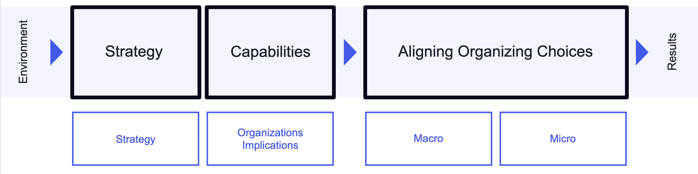
Organization Culture
Where to Intervene?
Culture: Assumptions, beliefs, behaviors, norms
Organization Choices
Decision Making
(What and How)
Which in turn drives organizational choices
Organization culture is self-reinforcing
and difficult to change

Slide 122
Strategic Cultural Behaviors & Leadership Practices
Example
 |  |  |  |  |  | WHEN?
Priority | Cultural Behaviors & Leadership Practices (Needed or Misaligned) | Strengthen or Diminish (+/-) | Target Audience | Behavioral Change and Action Plans | Resources | During Go Live | After Go Live
1 | Culture of innovative application (not proliferation) | + | Sr. Leaders | Collaboration between platform and LOB teams Clear product strategy | Platform Team 1 |  | X
2 | Prioritization of projects | + | Executives | Effective SBP | Nancy J., Jill K., Dan A., Kumar C. | X
3 | Change culture from fire-fighting to fire prevention | + | Line Leaders | Robust engineering implementation | Platform team 2 | X
4 | Change culture of always putting the ‘the best’ on the project | + | Line Leaders | Empowerment and delegation of authority | R&T and CES Product Teams | X
5 | Incorporate development mentality (teach vs. do) | + | Employees | Empowerment and delegation of authority | One rep from each platform team |  | X
6 | Change culture to value and price for software / calibration | + | Line Leaders | ?? |  |  | X

Slide 123
Strategic Culture Behaviors and Leadership Practice
Breakout
Consider the culture that will be required for the new strategy to be successful.
Things to keep in mind…
On a flipchart, list cultural behaviors and/or leadership practices that will be needed or that are misaligned with the strategy.
Identify those needed behaviors/practices that are truly competitive—they are essential for strategic differentiation. Mark these with a “Y” for competitive and an “N” for necessary but not competitive.
Choose one or two marked competitive and brainstorm actions that could be taken to encourage needed behaviors
or to extinguish misaligned behaviors.

Slide 124
Strategic Cultural Behaviors & Leadership Practices
Template
 |  |  |  |  |  | WHEN?
Priority | Cultural Behaviors & Leadership Practices (Needed or Misaligned) | Strengthen or Diminish (+/-) | Target Audience | Behavioral Change and Action Plans | Resources | During Go Live | After Go Live

Slide 125
Scenario Testing

Slide 126
Mastering the Cube
Scenario Testing Outcomes
Use cases that demonstrate how key actions and decisions will work

Slide 127
Micro Design Drill-Down
People and Rewards
Culture and
Leadership
Scenario
Testing
Micro to
Journey Bridge
STRATEGIC CULTURAL BEHAVIORS AND LEADERSHIP PRACTICES
USE CASE TESTING
BRIDGE TO REALIZATION
ROLE
DESIGN
STAFFING
DESIGN PRINCIPLES AND CRITERIA
Purpose | Describe roles and responsibilities for new/changed positions | Identify staffing drivers and/or ratios to rationalize the numbers of roles needed for key processes or functions | Identify key strategic behaviors or leadership practices that need to change – and how – to deliver the strategy and design intent | Facilitate stakeholder testing of design choices in real-life scenarios to identify gaps, risks or integration needs | Develop high-level plans to transition to and realize the recommended alignment choices
Output | Role profiles | Staffing estimates and assumptions | Strategic cultural behaviors and leadership practices chart | Use cases that demonstrate how key actions and decisions will work | High-level transition/implementation plan

Slide 128
Pressure Testing the Design
What is a Use Case?
A use case is an illustration of how decision rights and processes are designed to flow in the future state
They should be specific examples that illustrate the key roles, decisions and activities of the future state
Why do we do Use Cases?
They help ensure a shared understanding of a new design (high level process, organization structure, and roles)
They help identify additional risks and cross-functional integration needs across the larger team and develop “linkages” to address them

Slide 129
Scenario Testing
Identify Scenarios
Test
Scenarios
Report Out and Modify
Effective scenarios should be…
Two to three sentences​.
Detailed enough to be realistic and useful but not spelled out as an end-to-end process​.
​The norm, rather than focusing exclusively on exceptions​.
List high-level activities that would be performed in correct order​.
Use appropriate reference materials (process maps, RACI, etc.)​.
Capture the discussion in the use case template​.
Work with team and others to update the design if needed​.
Update process maps, RACI, and other documents as needed based on discovery of gaps in the design​.
Reflect insights and key recommended changes​.

Slide 130
Possible Scenarios to Test
How will new product development be managed?
How will policy deployment work in this new structure?
What will be key process metrics we need in place to identify possible problems in this design?
How will the monthly business reviews work?
What will be key escalation paths for issues?

Slide 131
Use Case
Template
Scenario Descriptions:
Step | Activity | ROLE 1 | ROLE 2 | ROLE 3 | ROLE 4 | ROLE 5 | ROLE 5 | Linkage / Assumptions
1
2
3
4
5
6
7
8
9
10

Slide 132
Use Case
Breakout
Illustrate how activities and decision rights are designed to flow in the future state.
Instructions
Select a limited set of everyday and/or crucial scenarios to test the new organization design.
For each scenario, list the key steps, decisions, roles, and responsibilities for the future state.
Gather the people impacted by the scenario.
Review the scenario steps and responsibilities, discuss, and adjust until understanding and agreement is reached.
As additional risks and cross-functional integration needed across the larger team become apparent, develop linkages to address them.

Slide 133
Micro to Journey Bridge

Slide 134
Micro Design Drill-Down
People and Rewards
Culture and
Leadership
Scenario
Testing
Micro to
Journey Bridge
STRATEGIC CULTURAL BEHAVIORS AND LEADERSHIP PRACTICES
USE CASE TESTING
BRIDGE TO REALIZATION
ROLE
DESIGN
STAFFING
DESIGN PRINCIPLES AND CRITERIA
Purpose | Describe roles and responsibilities for new/changed positions | Identify staffing drivers and/or ratios to rationalize the numbers of roles needed for key processes or functions | Identify key strategic behaviors or leadership practices that need to change – and how – to deliver the strategy and design intent | Facilitate stakeholder testing of design choices in real-life scenarios to identify gaps, risks or integration needs | Develop high-level plans to transition to and realize the recommended alignment choices
Output | Role profiles | Staffing estimates and assumptions | Strategic cultural behaviors and leadership practices chart | Use cases that demonstrate how key actions and decisions will work | High-level transition/implementation plan

Slide 135
AlignOrg Solution’s Organization Design Model
Strategy
Capabilities
Aligning Organizing Choices
Environment
Results
Strategy
Organizations Implications
Macro
Micro
Alignment is achieved by following the design sequence
How do we organize to best leverage organization capabilities?

Slide 136
Organization Transformation Roadmap
The AlignOrg Approach
How will the initiative be set-up for success?
How does your organization intend to “win”?
How should work and resources be configured to best enable strategy?
How will the new organization work and what capabilities need to be redesigned to drive execution?
How do we manage the change so we can realize the benefits of the new design?

Slide 137
Organization Alignment Activities: What’s Coming
Alignment Leadership
Strategy and Macro Design | Micro Planning | Micro Design | Change Management Planning | Implementation and Sustainability Journey Management
Purpose Set vision and strategy Identify and design strategic capabilities Develop operating model Determine organization structure at highest levels Set guidelines for micro / operational design | Select leaders for highest levels (L1 – L2) Select leaders/ sponsors and project manager for micro designs | Purpose Design Micro level choices | Select Leaders for L3 – L6(x) Select Project Manager for Journey Mgmt.
CHANGE MANAGEMENT
We are realizing our goals.
Detailed schedule
Communications strategy/plans
Physical move planning
PMO
Equipment movement
Financial/budget planning
Individual transition management
Organizational change management
INTEGRATION
PEOPLE MOVEMENT
I’m in my new role.
Job Creation
Descriptions
Grading
Success Metrics/rewards
Compensation
Legal review
Job Selection
Sourcing strategy
Post jobs
Apply for jobs
Selection
Job Moves
Changes to system
Physical moves
Budget changes
Security changes
Performance management plans
Skillset transfer
Training
On-boarding
Job training
Training development
Training
delivery
Design Area 1 (Work stream)
Design Area 2 (Work stream)
WORK LAUNCH
I’m doing my new role.
Processes
Level 3(x) process design
Work Guides
Job aid
Scripts
SOPs
Templates
Knowledge mgt. transfer
Metrics
SLAs
Operating metrics
Output metrics
Activities
Develop
Test
Train
Implement
TECHNOLOGY
I have the tools to do my new role
Requirements
Detailed design documents
Configuration parameters
Reporting
Solutions
Activities
Solution selection
Installation
Configuration and test
Go live
Design Area 3 (Work stream)
We are Here
Journey Management

Slide 138
Transition and Implementation Timeline
What are the key steps or phases of work to transition to and realize our recommendations?
What sequence do they need to be done in?
What timeframe is realistic for each?
What will the work streams be and who will be responsible and involved with each work stream?

Slide 139
Transition and Implementation Timeline
Breakout
Illustrate how activities and decision rights are designed to flow in the future state.
Brainstorm needed actions on Post-it Notes®
Place them on the Transition and Implementation Timeline wall chart under relevant work stream and timeframe.
Things to keep in mind
You may want to consult the Aligning Organizing Choices cube chart if available.

Slide 140
Transition and Implementation Timeline
Template
 | Phase 1 (e.g., Month, Quarter, etc.) | Phase 2 (Description) | Go Live | Post Go Live | Phase 3 (Description)
Work Stream A
Work Stream B
Work Stream C
Change/ Comms
HR

Slide 141
Implementation Work Stream Plan
Breakout
Define ownership and responsibilities for each Micro Design work stream.
Possible Work Streams
Group/Department work streams (for redesigning processes, developing process metrics, finalizing organization structures, clarifying decision rights, developing role descriptions, recommending staffing levels, identifying training and other transition needs).
Change/Communications work stream (for planning and coordinating all change management and transformation communication).
HR work stream (for finalizing job descriptions, planning selection processes, collaborating with group work streams on training plans, and other people and reward transformation needs).
Facilities work stream (for planning facilities changes).
IT work stream (for planning and designing IT changes).
Program management work stream (for managing the transformation program).

Slide 142
Implementation Work Stream Plan
Template
Work Stream | Owner | Team Members | Processes / Key Activities in Scope

Slide 143
Micro Design Drill-Down
People and Rewards
Culture and
Leadership
Scenario
Testing
Micro to
Journey Bridge
STRATEGIC CULTURAL BEHAVIORS AND LEADERSHIP PRACTICES
USE CASE TESTING
BRIDGE TO REALIZATION
ROLE
DESIGN
STAFFING
DESIGN PRINCIPLES AND CRITERIA
Purpose | Describe roles and responsibilities for new/changed positions | Identify staffing drivers and/or ratios to rationalize the numbers of roles needed for key processes or functions | Identify key strategic behaviors or leadership practices that need to change – and how – to deliver the strategy and design intent | Facilitate stakeholder testing of design choices in real-life scenarios to identify gaps, risks or integration needs | Develop high-level plans to transition to and realize the recommended alignment choices
Output | Role profiles | Staffing estimates and assumptions | Strategic cultural behaviors and leadership practices chart | Use cases that demonstrate how key actions and decisions will work | High-level transition/implementation plan

Slide 144
Organization Alignment Activities: What’s Coming
Alignment Leadership
Strategy and Macro Design | Micro Planning | Micro Design | Change Management Planning | Implementation and Sustainability Journey Management
Purpose Set vision and strategy Identify and design strategic capabilities Develop operating model Determine organization structure at highest levels Set guidelines for micro / operational design | Select leaders for highest levels (L1 – L2) Select leaders/ sponsors and project manager for micro designs | Purpose Design Micro level choices | Select Leaders for L3 – L6(x) Select Project Manager for Journey Mgmt.
CHANGE MANAGEMENT
We are realizing our goals.
Detailed schedule
Communications strategy/plans
Physical move planning
PMO
Equipment movement
Financial/budget planning
Individual transition management
Organizational change management
INTEGRATION
PEOPLE MOVEMENT
I’m in my new role.
Job Creation
Descriptions
Grading
Success Metrics/rewards
Compensation
Legal review
Job Selection
Sourcing strategy
Post jobs
Apply for jobs
Selection
Job Moves
Changes to system
Physical moves
Budget changes
Security changes
Performance management plans
Skillset transfer
Training
On-boarding
Job training
Training development
Training
delivery
Design Area 1 (Work stream)
Design Area 2 (Work stream)
WORK LAUNCH
I’m doing my new role.
Processes
Level 3(x) process design
Work Guides
Job aid
Scripts
SOPs
Templates
Knowledge mgt. transfer
Metrics
SLAs
Operating metrics
Output metrics
Activities
Develop
Test
Train
Implement
TECHNOLOGY
I have the tools to do my new role
Requirements
Detailed design documents
Configuration parameters
Reporting
Solutions
Activities
Solution selection
Installation
Configuration and test
Go live
Design Area 3 (Work stream)
Journey Management

Slide 145
Realization and Sustainability Journey
Implementation — Finishing the Journey
Initiation
1-2 Weeks
Change and Implementation Planning
2-8 weeks
Implementation
2-6 months
Sustain
Change Gate
Change Gate
Change Gate
Change Gate
Set Up
Business Case
Journey Assessment
Change Plan
Change Management
Periodic
Transformation Outcome Reviews
Change Management
People Enablement
I’m in my
new role.
People Enablement Plan
People Movement Assessment
Coach and Monitor People Movement
Work
Alignment and Engagement
(and Governance)
I’m doing
my new role.
Journey Management Plan
Work Alignment and Engagement Plan
Coach and Monitor Work Launch
Work
Assessment and Completion
Materials Development
Technology Enablement
(Coordinate w/
technology launch)
I have the tools
to do my new role.
Technology Impact Assessment
Technology Enablement Plan
Coach and Monitor Technology Integration

Slide 146
Change Readiness Assessment
Breakout
Assess the group’s level of change readiness.
Instructions
Individually complete the assessment.
For each question assign rating:
    3 = Green (true or ready)
    2 = Yellow (somewhat true or somewhat ready)
    1 = Red (not true or not ready)
Calculate category average.
Determine group average for each category (NOT each question) and complete slide – with number average and color code.
Develop action plan to close gaps.
    Start with reds first
    Create Post-it Note® for each action
Place Post-it Note® on transition timeline under change management and communication work stream.

Slide 147
Change Readiness Assessment
The following statements suggest how ready an organization and its people are for change. Rate the extent to which they are true. |  | Not True | Somewhat True | True | Clarification: List the specific issues or reasons why an item is “Not True” or “Somewhat True.”
Compelling Business Case | The desired future state is clearly necessary. | 1 | 2 | 3
 | Relevant information exists which supports the need for change. | 1 | 2 | 3
 | An accurate picture of the organization’s current condition (financial, competition, labor, etc.) is available. | 1 | 2 | 3
 | The need for change is greater than the resistance to the change. | 1 | 2 | 3
 |  | Category Average =
Understanding | The gap between current state and desired future state is clear. | 1 | 2 | 3
 | People believe that the change is good, reasonable, and appropriate. | 1 | 2 | 3
 | People have sufficient access to external market information showing the organization’s competitive weaknesses or performance deficiencies. | 1 | 2 | 3
 | The objectives of the change have been widely and clearly communicated. | 1 | 2 | 3
 |  | Category Average =

Slide 148
Change Readiness Assessment
The following statements suggest how ready an organization and its people are for change. Rate the extent to which they are true. |  | Not True | Somewhat True | True | Clarification: List the specific issues or reasons why an item is “Not True” or “Somewhat True.”
Leadership Commitment | Leaders are committed (words and actions) to making this change happen. | 1 | 2 | 3
 | Behavioral and performance expectations have been articulated. | 1 | 2 | 3
 | The priorities that will guide decision making during implementation have been communicated. | 1 | 2 | 3
 |  | Category Average =
Individual Capabilities (Tools/Skills) | People feel prepared to address the disruption (personal and professional) caused by this change. | 1 | 2 | 3
 | People have the necessary resources, knowledge, information, and skills to support and participate in the change. | 1 | 2 | 3
 | New roles and responsibilities (if applicable) have been established. | 1 | 2 | 3
 | People understand and accept the new roles they are being asked to play. | 1 | 2 | 3
 |  | Category Average =

Slide 149
Change Readiness Assessment
The following statements suggest how ready an organization and its people are for change. Rate the extent to which they are true. |  | Not True | Somewhat True | True | Clarification: List the specific issues or reasons why an item is “Not True” or “Somewhat True.”
Organization Capabilities (Processes/ Systems/ Structures) | Information and feedback is available to inform the organization about how well the change is going. | 1 | 2 | 3
 | The organization has the capabilities and processes to implement/execute the change(s). | 1 | 2 | 3
 | Processes, systems, and structures exist, or are being developed, which are needed to support the change. | 1 | 2 | 3
 |  | Category Average =
Stakeholder Response | Feedback from key stakeholders (customers, associates, shareholders, suppliers, etc.) has been incorporated into the change plan. | 1 | 2 | 3
 | Key stakeholders who must support and be involved with the change have been identified. | 1 | 2 | 3
 | There is no significant resistance to the change. | 1 | 2 | 3
 | Individuals are being given the support and time needed to learn about and accept the change. | 1 | 2 | 3
 | The readiness for change has been regularly measured and monitored throughout the change process.
 |  | Category Average =

Slide 150
Change Readiness Assessment
The following statements suggest how ready an organization and its people are for change. Rate the extent to which they are true. |  | Not True | Somewhat True | True | Clarification: List the specific issues or reasons why an item is “Not True” or “Somewhat True.”
Resources and Competing Events | The action items and responsibilities required to implement the change have been defined. | 1 | 2 | 3
 | There are no other events or projects competing for resources and attention. | 1 | 2 | 3
 | This change is congruent/consistent with other initiatives in the organization. | 1 | 2 | 3
 |  | Category Average =
Category Average |  | Action
1.0 – 1.8 | Not Ready | Develop Action Plans to Align the Organization
1.9 – 2.2 | Somewhat Ready | Identify Key Alignment Tactics Based on Criticality to Strategy; Take Mitigating Actions as Needed
2.3 – 3.0 | Well Ready | Ready; No Mitigation Needed at This Time

Slide 151
Change Readiness Assessment Summary
 | Average Rating | Countermeasures
Compelling Business Case
Understanding
Leadership Commitment
Individual Capabilities
Organization Capabilities
Stakeholder Response
Resource and Competing Events

Slide 152
Immediate Next Steps
Template
What? | When? | Who?
What are the key action items we have agreed to move forward on? | When do we intend to have these things completed? | Who will be taking point on these actions?

Slide 153
Communications Agreement
Who are the key audiences?
What are the primary messages?
What can we / can’t we say?

Slide 154
Communications Agreements
Example
Communications Agreements
What to share | What not to share
Reinforce earlier talking points and FAQs. Using a structured design process with an external organization design facilitator. No decisions finalized; still a work in progress. | Details. Documentation. Who said what during session.

