Slide 1
Internet Operating Model
Example
Power Sport
Dealers
Auto Dealers
No Fees
RV Dealers
Home
Improvement
Dealers
Extended
Warranties
(pay/funded deal)
Credit
Decisioning
Tools
(Lender Pays)
Internet
Credit Bureaus
(payment through
bureaus from dealer)
Value Chain
Products and
Services
(no charge)
Portal Web
Application
Credit Insurance
(pay/funded deal)
Product
Documentation
(No charge)
System Interface
Lenders
CSC
Prime
(pay/funded deal)
Lenders
Balloon Note
Prime
(pay/funded deal)
Fee Based
Lenders
Non-Prime
(pay/funded deal)
Lenders
Lease
(pay/funded deal)

Slide 2
Blockbuster Operating Model
Marketing
Movie
Suppliers
DVD
Manufacturing
Distribution
Consumers
Retail Stores
Sourcing and
Contracting
Support Organizations

Slide 3
Operating Model
Future State “Hybrid, Center-led” IT Organization
PRIORITIZATION
BUSINESS UNIT-SPECIFIC
CENTER-LED
DEMAND
Project Requests
EMEA
IT Strategy
ePMO
Infrastructure
IT Operations/Help
Desk
Security
Enterprise Apps
Architecture
ASIA
North America
Enhancement Requests
Pacific
LATAM
KTLO Support
Vertical Market Solutions
Products
Corporate Functions
(e.g., Finance, HR)
COMMON SUPPORT PROCESSES (e.g., Release Management and Production Control, Portfolio Management, Quality Assurance)

Slide 4
Operating Model
Example: Financial Services Enterprise

Slide 5
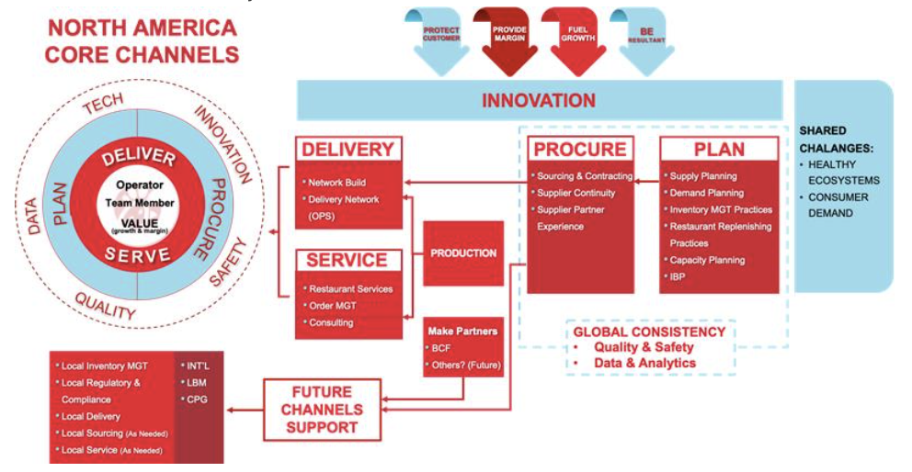
Operating Model
Example: Food Services Supply Chain

