Slide 1

Mastering the Cube
Categorization and placement of competitive, enabling, necessary and compliance work activities.
Design operating model to ensure alignment on high-level business processes and strategically group work together.

Slide 2


Work Categorization Example
Ryanair vs Emirates
ANCHOR
Work Activities
Directly makes the strategy happen
Essential
to the
business
Enables the
strategic work
'Must do' work
Plane
Turn
Uniform
Fleet
Payroll
Taxes
Amenities and On-board features
Fleet
Configuration
Service
Taxes
Not All Work is Equal…Strategically

Slide 3
Work Categorization Questions
Competitive Activities | Competitive Enabling Activities | Necessary Activities | Compliance
Does this work have a direct impact on gaining market share to make your strategy happen?​ ​ Does it directly impact your ANCHOR(s)? ​ ​ Will the activity directly create sustainable differentiation?​ ​ If we were forced to give up control of work, would this be the last thing we would give up? ​ | Are the outputs of this work used by or consumed by a competitive work activity? ​ ​ Does it directly enable a competitive work activity?​ ​ Do we do this work because of our company’s values/ beliefs? | Is it essential to the business, but not to gaining market share?​ ​ Is it only a potential disadvantage? ​ ​ Could we afford to be at par with our competitors? ​ ​ | Do we do this because we don’t want to go to jail or get fined?​ ​ If allowed, would we stop doing this work?
Effectiveness
Efficiency

Slide 4
Placement of Work
Definition
Unique Work
Controlled and resourced locally
UNIQUE – Work done in many places in different ways.
Standardized
Work
STANDARD – Work done in many places in standardized ways.
Unique Work
Controlled and resourced locally
Unique Work
Controlled and resourced locally
Standardized
Work
Standardized
Work
Shared Work
Controlled and resourced centrally
SHARED – Work done in one team or group in the same way. (Essentially, someone does the work for everyone else.)

Slide 5
Placing and Locating Work
There is relationship between categorization and placement of work
 | Competitive Work | Competitive Enabling Work | Necessary Work | Compliance Work
“Unique work”
“Work done same way” (Standard)
“Shared work”

Slide 6
Work Categorization and Placement
Examples
 | COMPETITIVE | ENABLING | NECESSARY | COMPLIANCE
UNIQUE | Partner with appropriate departments to get necessary data (screen pops, etc.) to service specific groups (e.g. cancer patients).
STANDARD | Call providers and pharmacies, etc. Take payment for providers. Do case management. Manage triggers for proactive action on ongoing basis. Build model to educate members’ wellness. | Manage feedback from member advisory council. Schedule appointments for members. Schedule and conduct welcome calls and events. Scan authorizations for heads up on member health issues. Build customer intimacy moments. | Implement communication plans.
SHARED | Partner with marketing to line up patient event collectively. Create customer advisory council. Plan and manage webcasts. | Review agent scorecard. Resolve member issues. Update agents on changes. Review quality monitors. Report system issues. Meet regulatory guidelines. (HIPAA). Answer calls. Email/fax EOBs. Conduct team meetings. | Reach out to other areas. Follow-up on inventory processing. Respond to appeals within compliance. Do member call backs. Report out to CMS. Respond to complaints, grievances, and appeals. | Planning and conducting proactive outbound calls. Train on new and updated processes and skillsets. Handle executive inquiries (chairman’s team). Talent development to supervisor level (e.g. 9 block).
Effectiveness
Efficiency

Slide 7
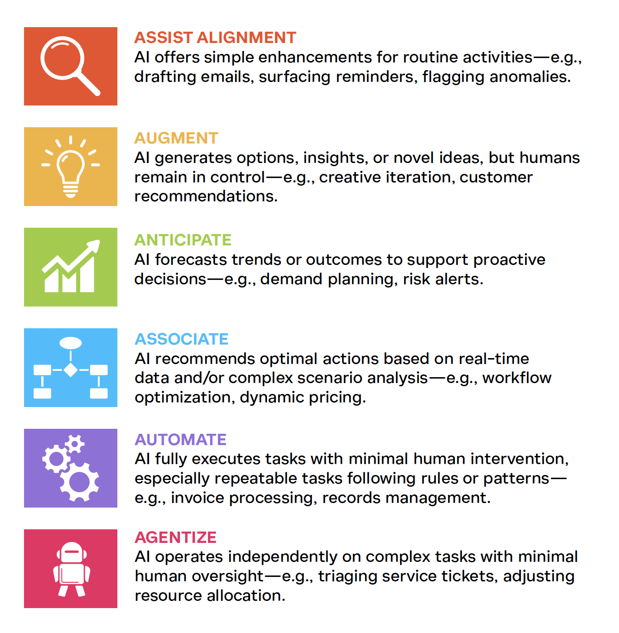
AI Work Evaluation
Is AI right for my organization?
The answer is not Yes or No, it's how much.

Slide 8
Work Categorization and Placement + AI
Examples
 | COMPETITIVE | ENABLING | NECESSARY (Human Led) | NECESSARY (AI / Automate) | COMPLIANCE
UNIQUE | Partner with appropriate departments to get necessary data (screen pops, etc.) to service specific groups (e.g. cancer patients).
STANDARD | Call providers and pharmacies, etc. Take payment for providers. Do case management. Manage triggers for proactive action on ongoing basis. Build model to educate members’ wellness. | Manage feedback from member advisory council. Schedule appointments for members. Schedule and conduct welcome calls and events. Scan authorizations for heads up on member health issues. Build customer intimacy moments. | Implement communication plans.
SHARED | Partner with marketing to line up patient event collectively. Create customer advisory council. Plan and manage webcasts. | Review agent scorecard. Resolve member issues. Update agents on changes. Review quality monitors. Report system issues. Meet regulatory guidelines. (HIPAA). Answer calls. Email/fax EOBs. Conduct team meetings. | Reach out to other areas. Report out to CMS. Respond to complaints, grievances, and appeals. | Follow-up on inventory processing. Respond to appeals within compliance. Do member call backs. | Planning and conducting proactive outbound calls. Train on new and updated processes and skillsets. Handle executive inquiries (chairman’s team). Talent development to supervisor level (e.g. 9 block).
Effectiveness
Efficiency

